Slide 1
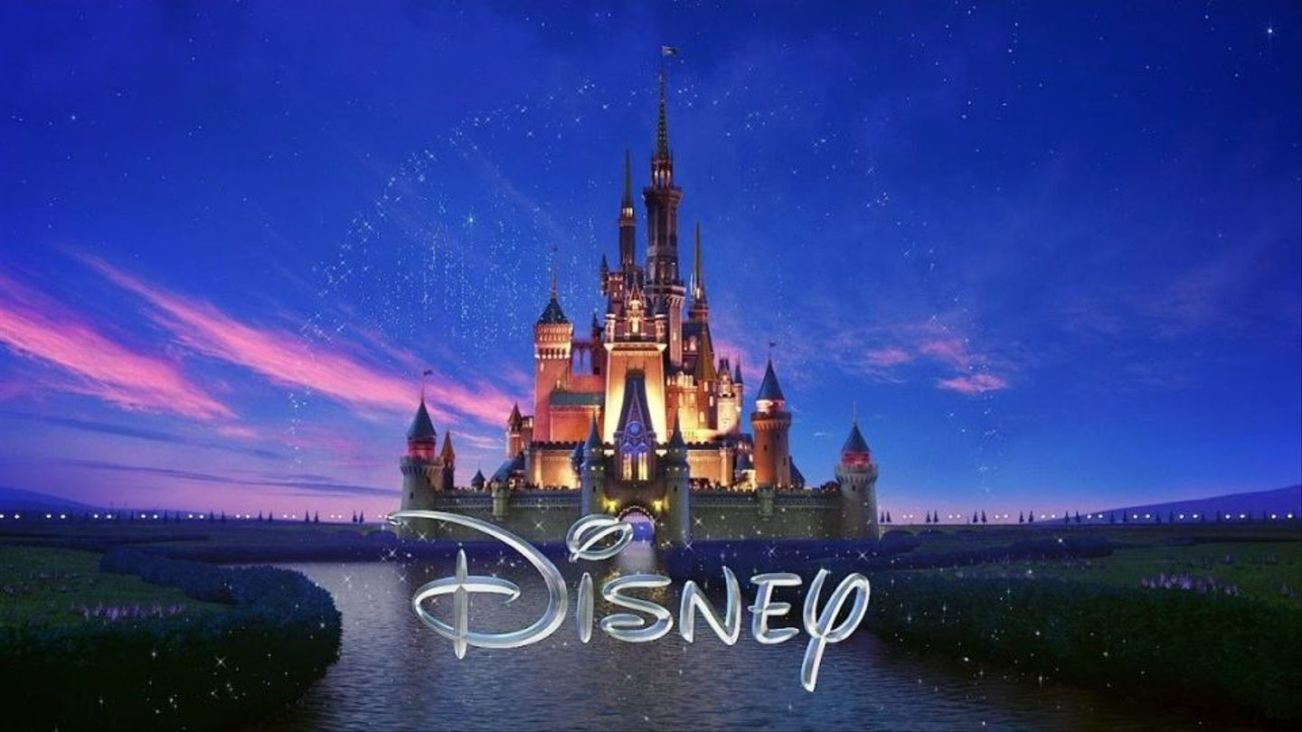
Guess the Disney Movie Answers

Slide 2
PRINCESS AND THE FROG

Slide 3
FROZEN

Slide 4
MOANA

Slide 5
LION KING

Slide 6
UP

Slide 7
SNOW WHITE

Slide 8
ALADDIN

Slide 9
MARY POPPINS

Slide 10
BEAUTY AND THE BEAST

Slide 11
LADY AND THE TRAMP

Slide 12
FINDING NEMO

Slide 13
SLEEPING BEAUTY

Slide 14
OLIVER AND COMPANY

Slide 15
TOY STORY

Slide 16
CARS

Slide 17
PETER PAN

Slide 18
TARZAN

Slide 19
CINDERELLA

Slide 20
ZOOTOPIA

Slide 21
BIG HERO 6

Slide 22
CAPTAIN AMERICA: THE FIRST AVENGER

Slide 23
THOR

Slide 24
HERCULES

Slide 25
THE RESCUERS

Slide 26
THE JUNGLE BOOK

Slide 27
IRON MAN

Slide 28
THE ARISTOCATS

Slide 29
MULAN

Slide 30
BLACK PANTHER

