Slide 1
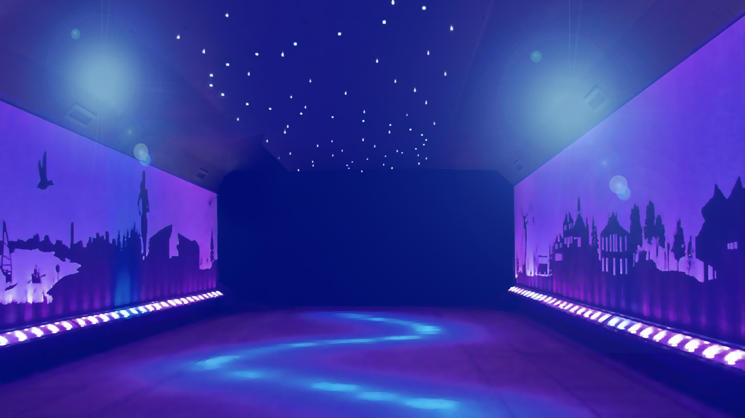


JEOPARODY JEOPARODY JEOPARODY JEOPARODY JEOPARODY JEOPARODY JEOPARODY JEOPARODY JEOPARODY JEOPARODY JEOPARODY JEOPARODY JEOPARODY JEOPARODY JEOPARODY JEOPARODY JEOPARODY JEOPARODY JEOPARODY
JEOPARODY JEOPARODY JEOPARODY JEOPARODY JEOPARODY JEOPARODY JEOPARODY JEOPARODY JEOPARODY JEOPARODY JEOPARODY JEOPARODY JEOPARODY JEOPARODY JEOPARODY JEOPARODY JEOPARODY JEOPARODY JEOPARODY

Slide 2
HERE ARE TODAY’S CATEGORIES

Slide 3

General
NWSRA

Slide 4
Animals

Slide 5
PURSUIT
Sites

Slide 6
Staff

Slide 7
Community Outings

Slide 8
Park
Districts

Slide 9

General NWSRA
Animals
PURSUIT Sites
Staff
Community Outings
Park Districts
$100
$100
$100
$100
$100
$100
$200
$200
$200
$200
$200
$200
$300
$300
$300
$300
$300
$300
$400
$400
$400
$400
$400
$400
$500
$500
$500
$500
$500
$500
FINAL JEOPARODY

Slide 10
General NWSRA $100
What color is the NWSRA logo?

Slide 11

General NWSRA $100
Purple

Slide 12
General NWSRA $200
Where is the main office?

Slide 13
General NWSRA $200
Rolling Meadows

Slide 14
General NWSRA $300
How many park districts does NWSRA serve?

Slide 15
General NWSRA $300
17

Slide 16
General NWSRA $400
Who helps NWSRA raise money? Hint: Their colors are red and black.

Slide 17

General NWSRA $400
SLSF

Slide 18
General NWSRA $500
What was PURSUIT’s original name?

Slide 19
General NWSRA $500
YAMO

Slide 20
Animals $100
What type of animal lives at each site?

Slide 21
Animals $100
A Turtle

Slide 22
Animals $200
What does Star eat?

Slide 23
Animals $200
Crickets

Slide 24
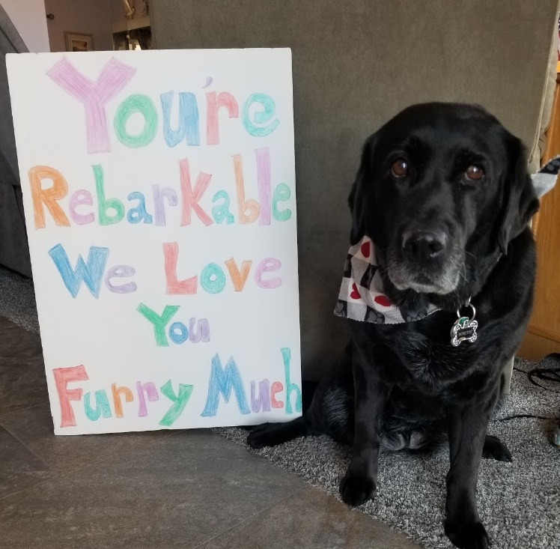
Animals $300
What sites
does
Dorothy visit?

Slide 25
Animals $300
Hanover Park & Rolling Meadows

Slide 26
Animals $400
What is the name of the turtle at PURSUIT Rolling Meadows?

Slide 27
Animals $400
Crush

Slide 28
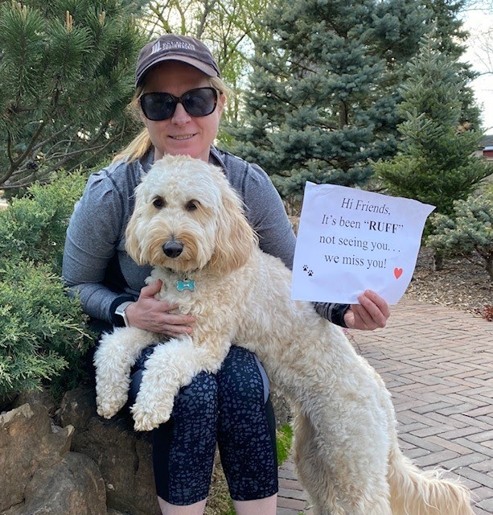
Animals $500
What is the
name of this
therapy dog?

Slide 29
Animals $500
Winnie

Slide 30
PURSUIT Sites $100
Which PURSUIT site has the Dream Lab?

Slide 31
PURSUIT Sites $100
PURSUIT
Rolling Meadows

Slide 32
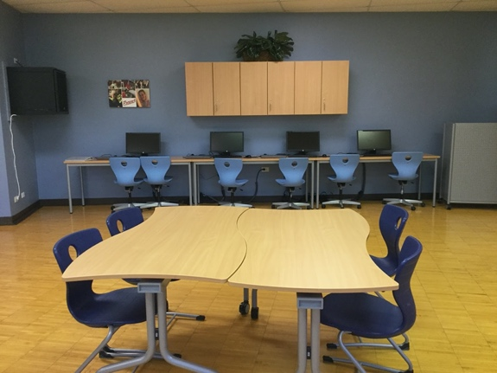
PURSUIT Sites $200
Which site
is this?

Slide 33
PURSUIT Sites $200
PURSUIT Hanover Park

Slide 34
PURSUIT Sites $300
What was the first PURSUIT Site to open?

Slide 35
PURSUIT Sites $300
PURSUIT
Rolling Meadows

Slide 36
PURSUIT Sites $400
Where is PURSUIT #4?
Hint: This is our newest PURSUIT!

Slide 37
PURSUIT Sites $400
PURSUIT Wheeling

Slide 38
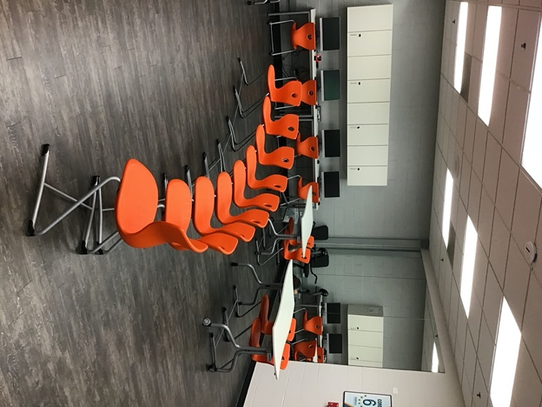
PURSUIT Sites $500
Which site
has orange chairs?

Slide 39
PURSUIT Sites $500
PURSUIT
Mount Prospect

Slide 40
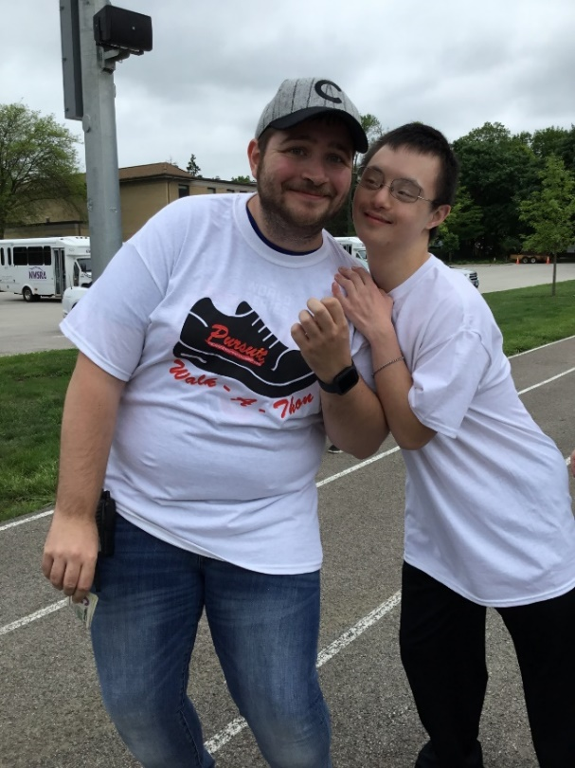
Staff $100
Where does
this staff
work?

Slide 41
Staff $100
Vinnie from
PURSUIT Hanover Park

Slide 42
Staff $200
Who leads morning routine at PURSUIT Mount Prospect?

Slide 43
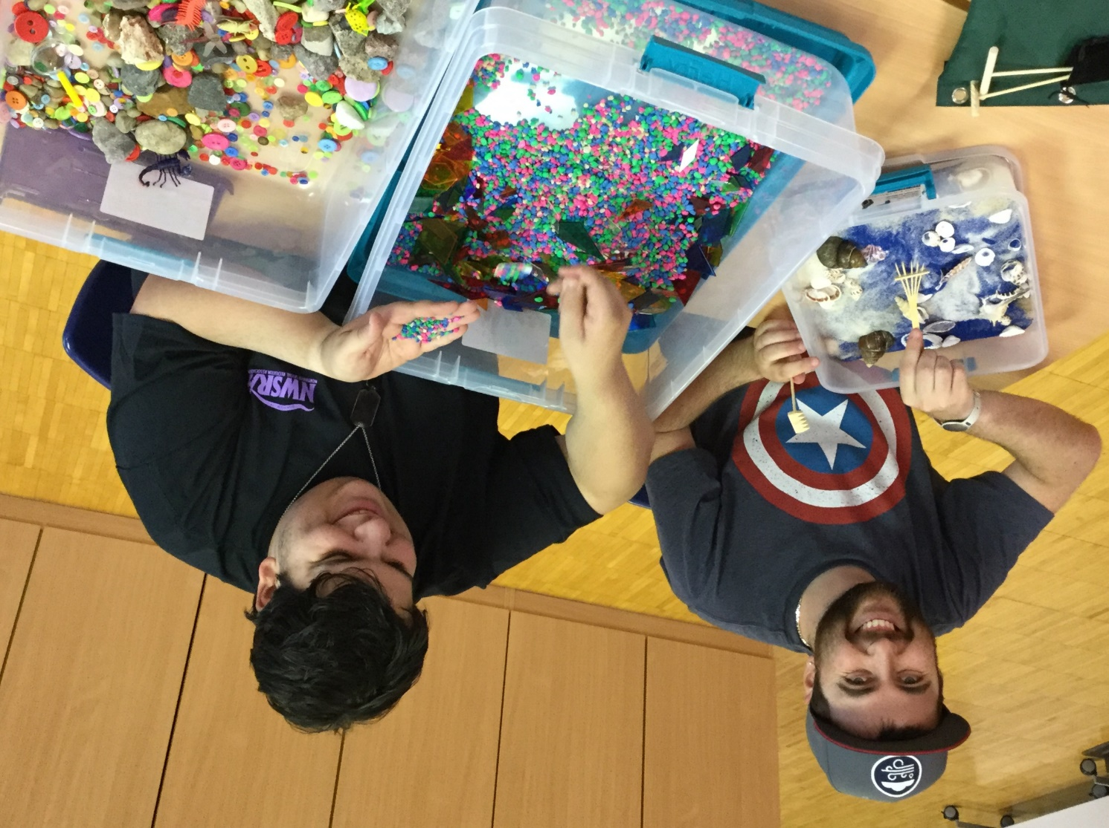
Staff $200
Aidan

Slide 44
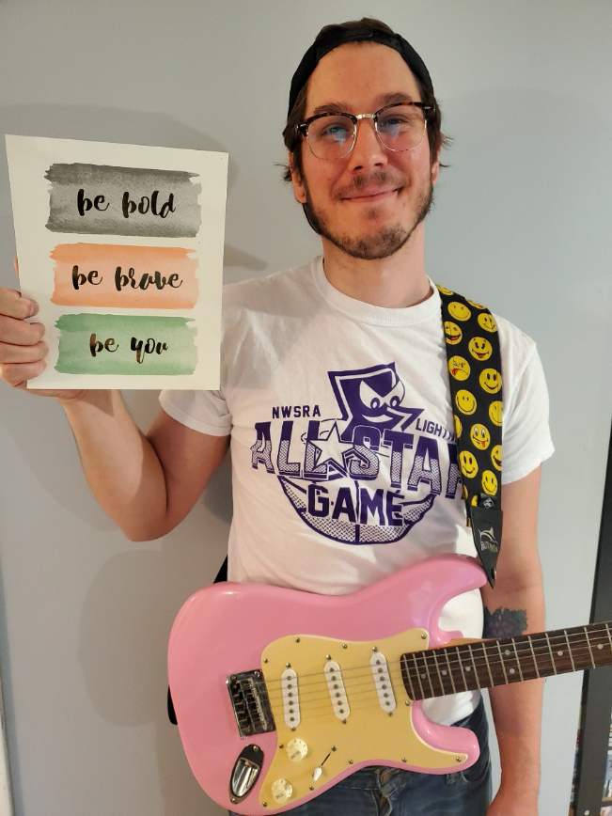
Staff $300
What does
Jake teach
us at
PURSUIT?

Slide 45
Staff $300
Music

Slide 46
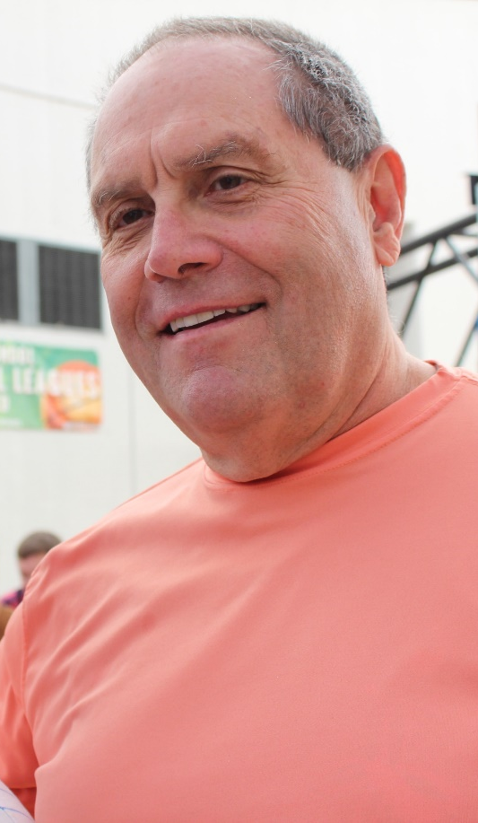
Staff $400
What is
this staff’s nickname?

Slide 47
Staff $400
Captain Bill

Slide 48
Staff $500
Who was the first PURSUIT staff?

Slide 49
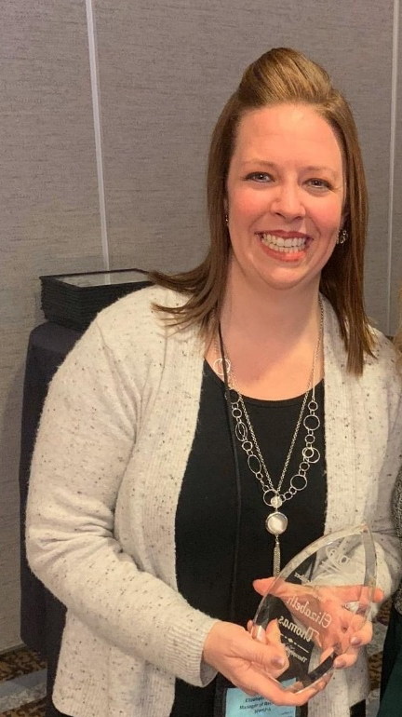
Staff $500
Liz Thomas

Slide 50
Community Outings $100
Which site hosts all of the dances?

Slide 51
Community Outings $100
PURSUIT Hanover Park

Slide 52
Community Outings $200
What did the food trucks serve at our parking lot party last summer?

Slide 53
Community Outings $200
Ice Cream

Slide 54
Community Outings $300
What do we get for lunch at the movies?

Slide 55
Community Outings $300
Hot Dog and Popcorn

Slide 56
Community Outings $400
Which pumpkin patch has pig races?

Slide 57
Community Outings $400
Bengston’s

Slide 58
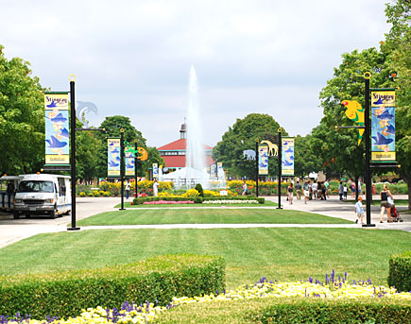
Community Outings $500
Where does
PURSUIT go
every summer
for All SRA Day?

Slide 59
Community Outings $500
Brookfield Zoo

Slide 60
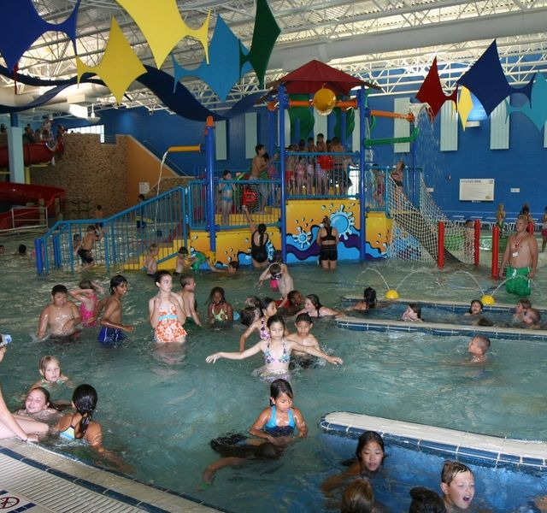
Park Districts $100
What park
district is
this?

Slide 61
Park Districts $100
Schaumburg
Scaumburg CRC – Water Works

Slide 62
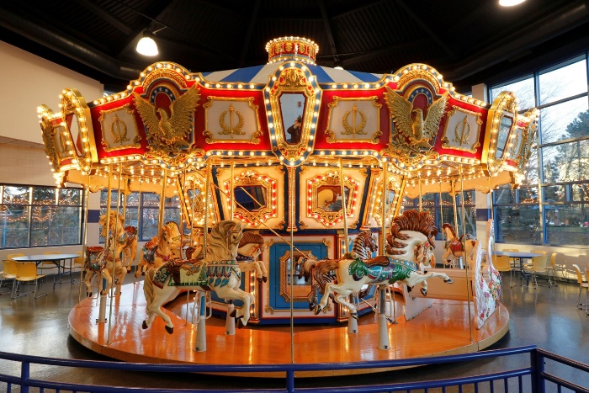
Park Districts $200
What park
district has
a carousel?

Slide 63
Park Districts $200
Elk Grove Village
Jack Claes Pavilion

Slide 64
Park Districts $300
What park district has indoor tennis courts?

Slide 65
Park Districts $300
Hanover Park

Slide 66
Park Districts $400
Which park district has a mini-golf course?

Slide 67
Park Districts $400
River Trails

Slide 68
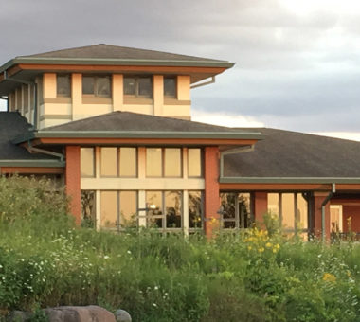
Park Districts $500
What park
district do
we visit
reptiles?

Slide 69
Park Districts $500
Bartlett
Bartlett Nature Center

Slide 70



Slide 71
How old is PURSUIT?
OR
What year did PURSUIT open?
Start Timer
GO TO
PROMPT
(RESPONSE)

Slide 72
Opened in 2014
6 years old

