Slide 1
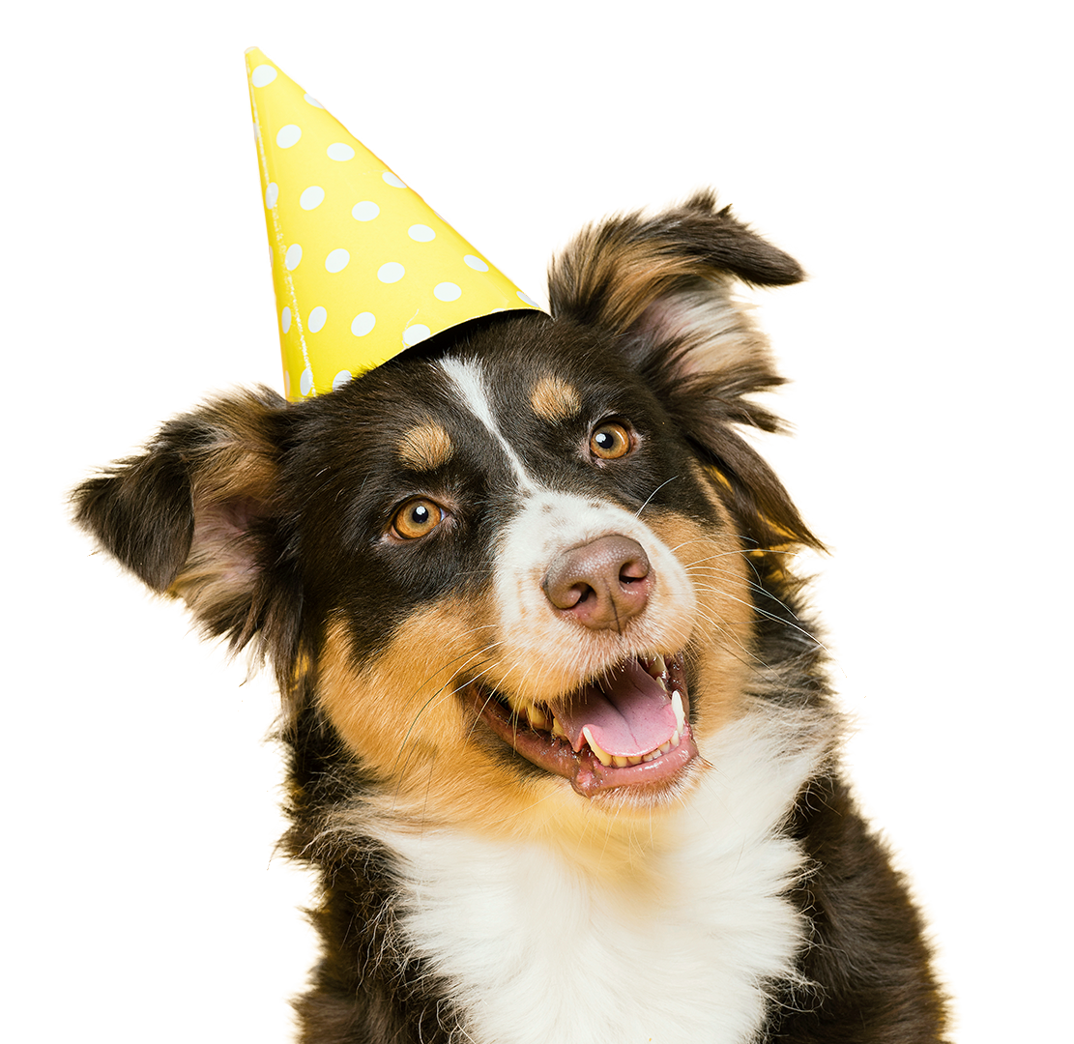
NWSRA’s
DOG SHOW

Slide 2

What will we cover?
Dog Trivia
Real - Life Dog Show Pups
Fun for your Dog

Slide 3
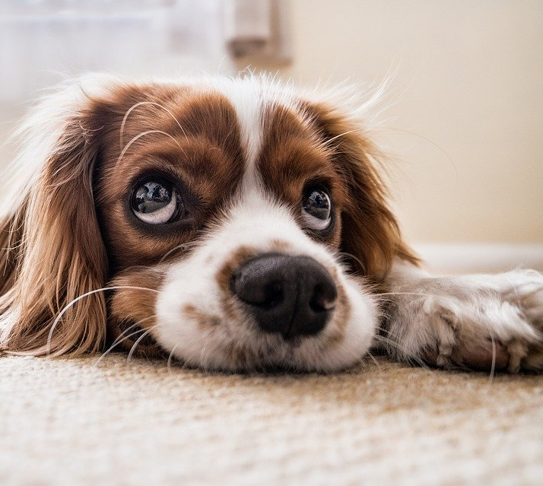
Dog Trivia

Slide 4
True or False?

Slide 5
Dogs noses are wet to help absorb scent chemicals

Slide 6
True !
Dogs wet noses help them absorb smells

Slide 7
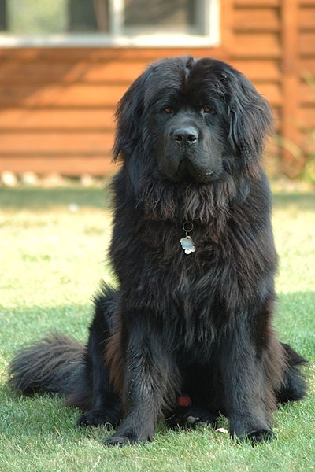
Newfoundlands are amazing lifeguards

Slide 8
True !
Newfoundland dogs are the ultimate doggy lifeguards, because they have water resistant coats and webbed feet. They were originally bred as fisherman’s helpers and to rescue people from drowning. Some owners have even reported that their Newfoundland tries to “rescue” them when they’re swimming!

Slide 9
There is a type of dog that yodels instead of barking.

Slide 10
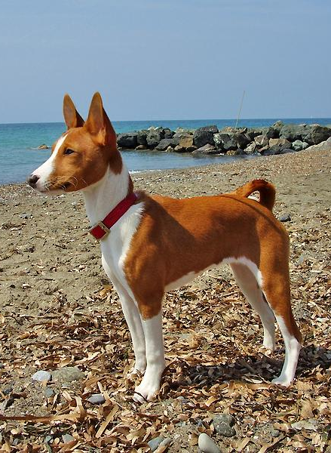
True !
Basenji dogs yodel, whine and scream

Slide 11
Some dogs have black tongues.

Slide 12
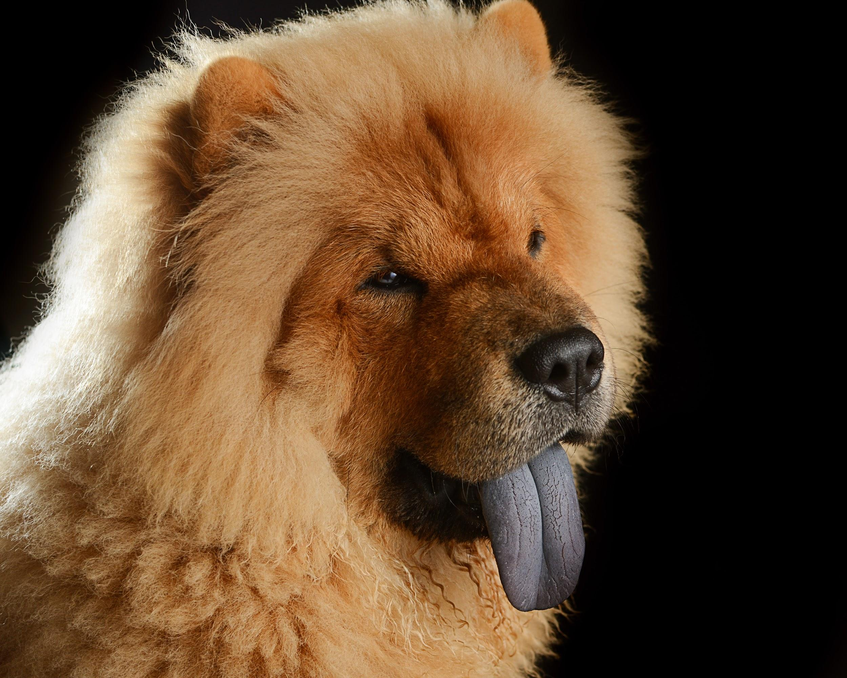
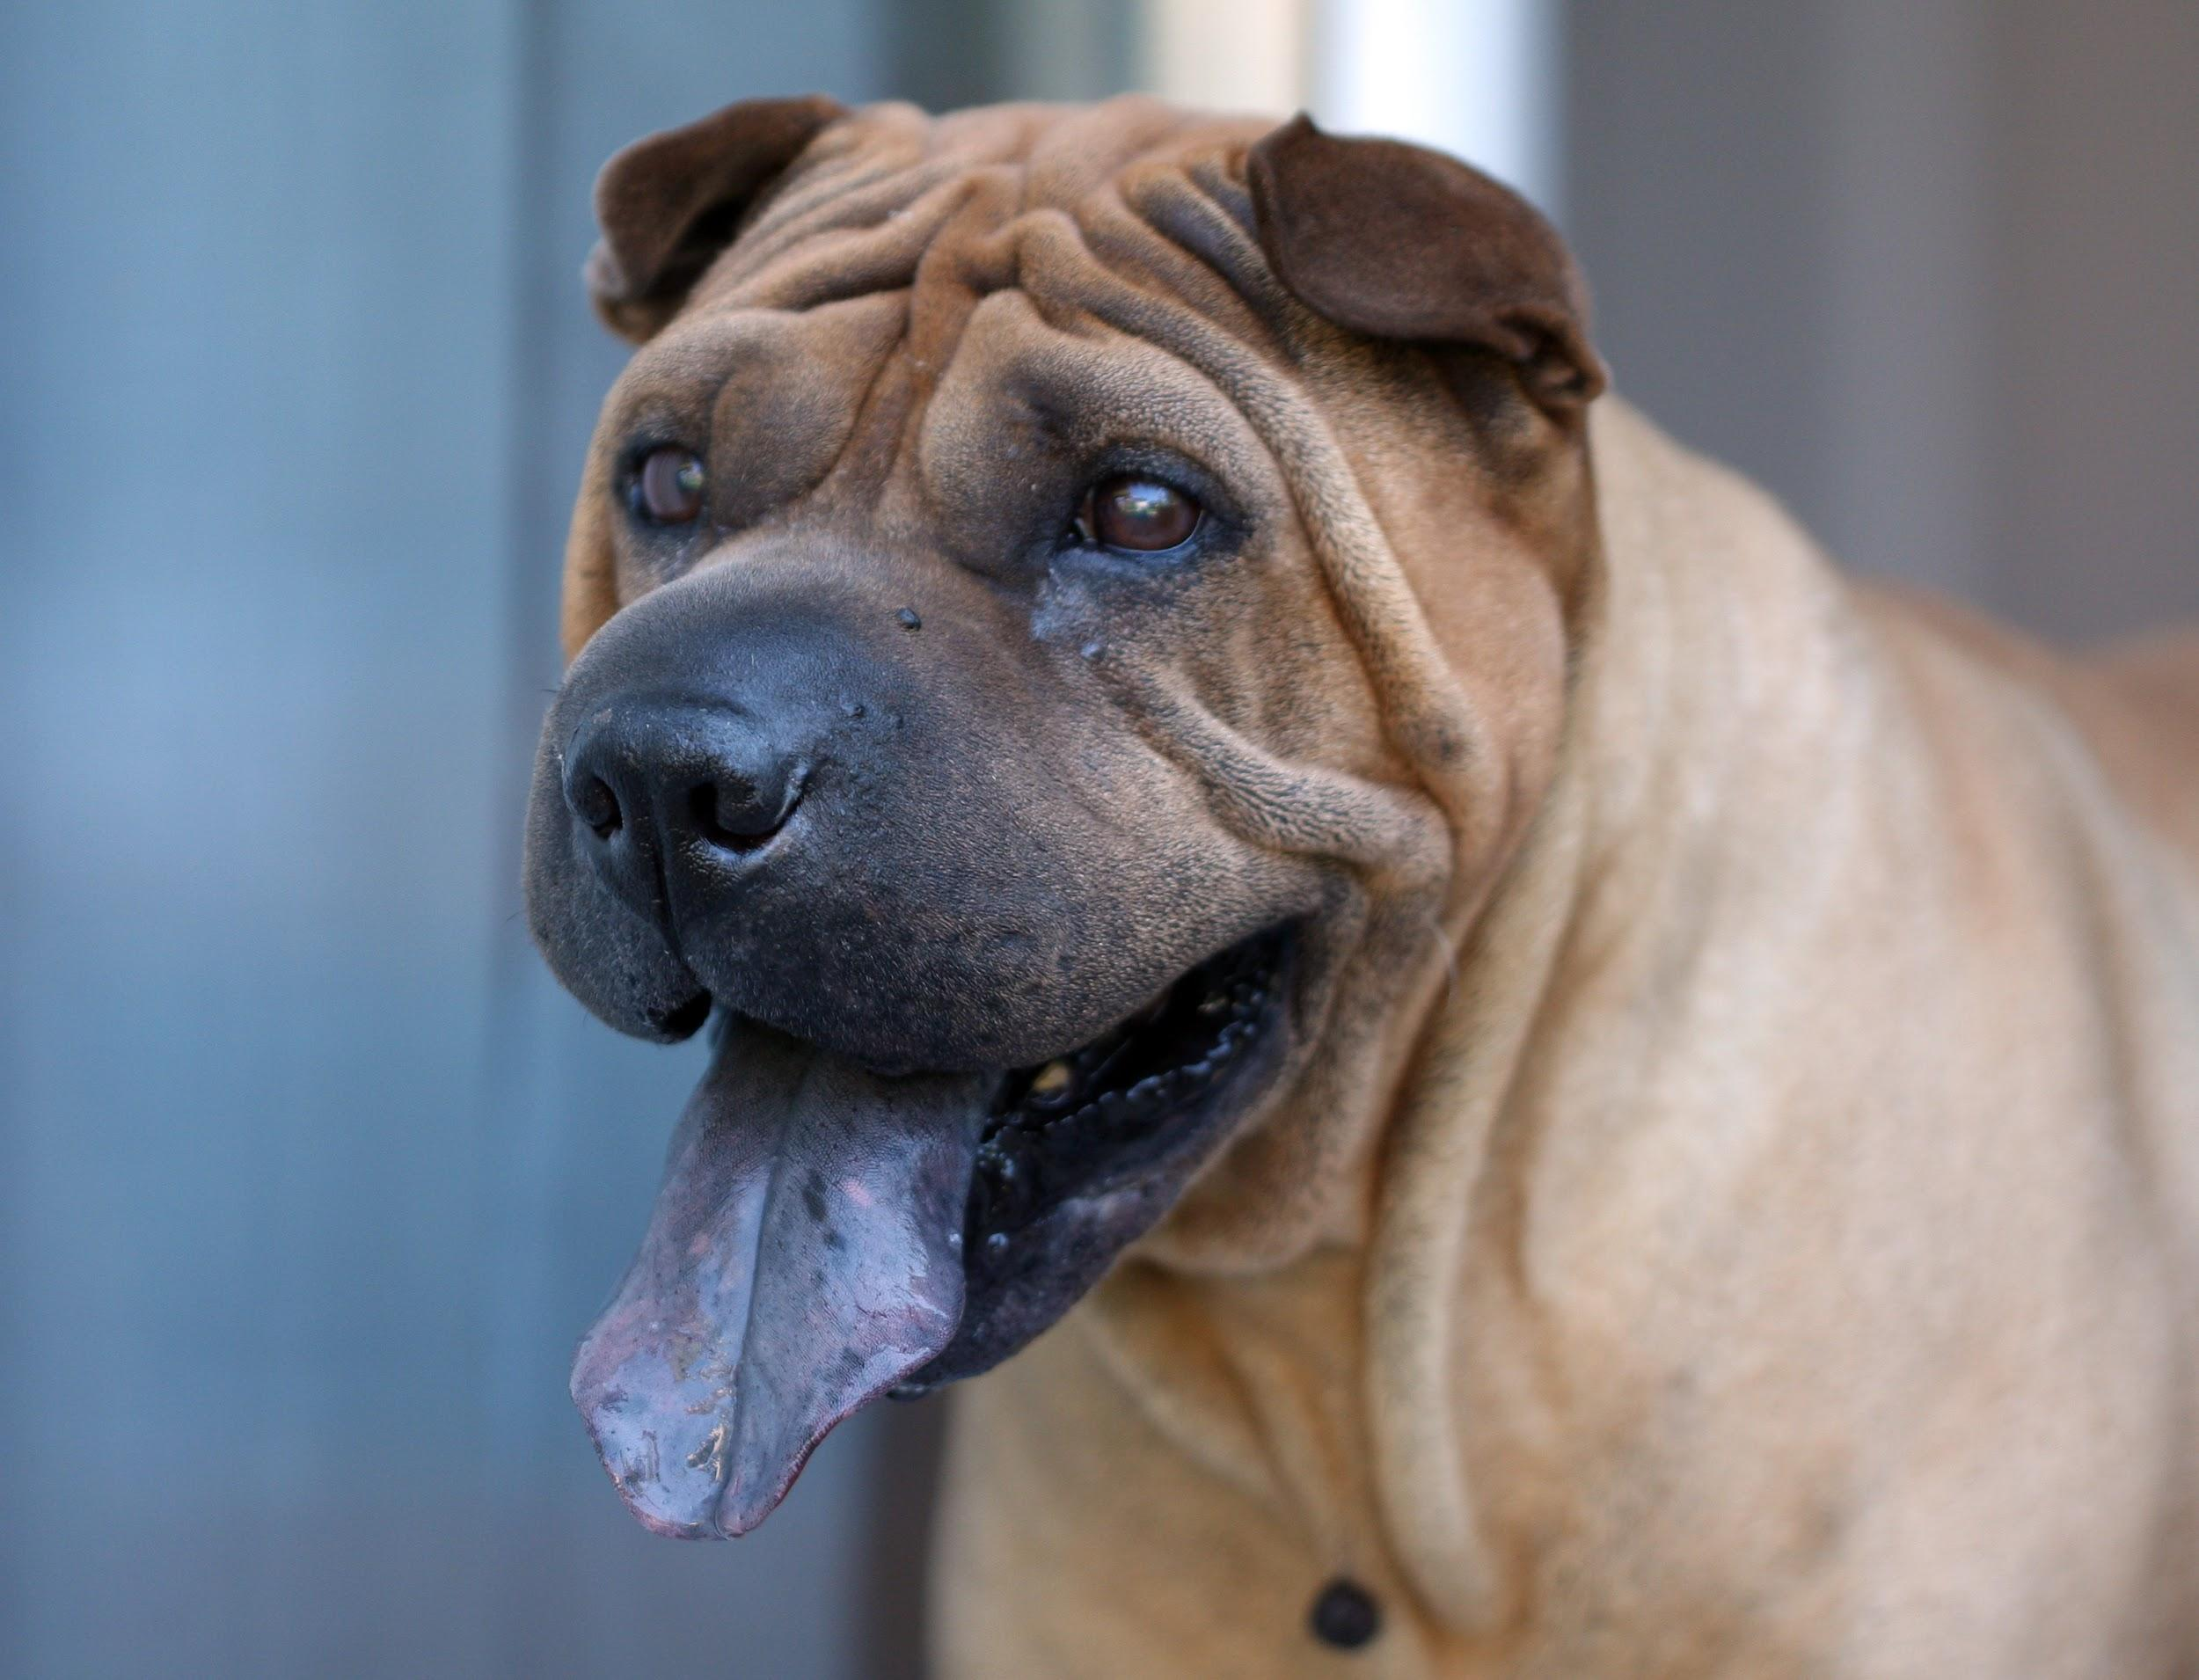
True !
Chow Chows and Sharpeis have black tongues

Slide 13

The Ewoks in Star Wars were based on a dog

Slide 14
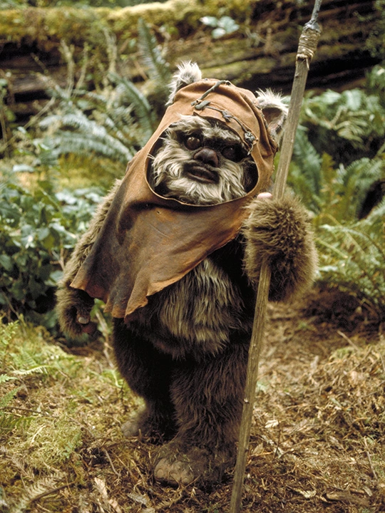
True !
George Lucas modelled the Ewoks after his family dog

Slide 15
The tallest dog in the world is 44 inches tall

Slide 16
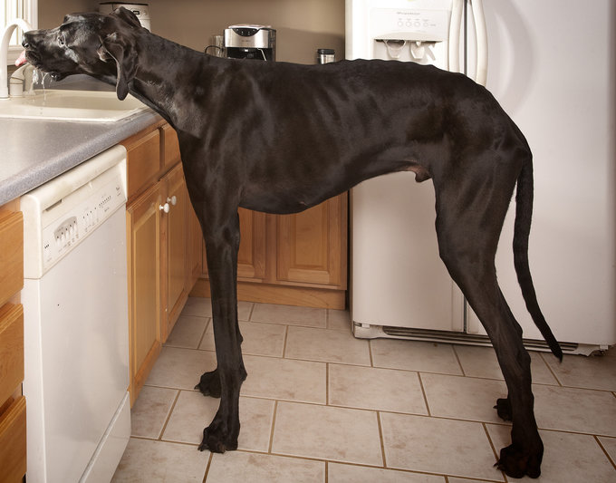
True !
The tallest dog in the world ever was a Great Dane named Zeus! Measured at 44 inches tall on October 4th 2011, he’s the current Guinness World Record holder.

Slide 17
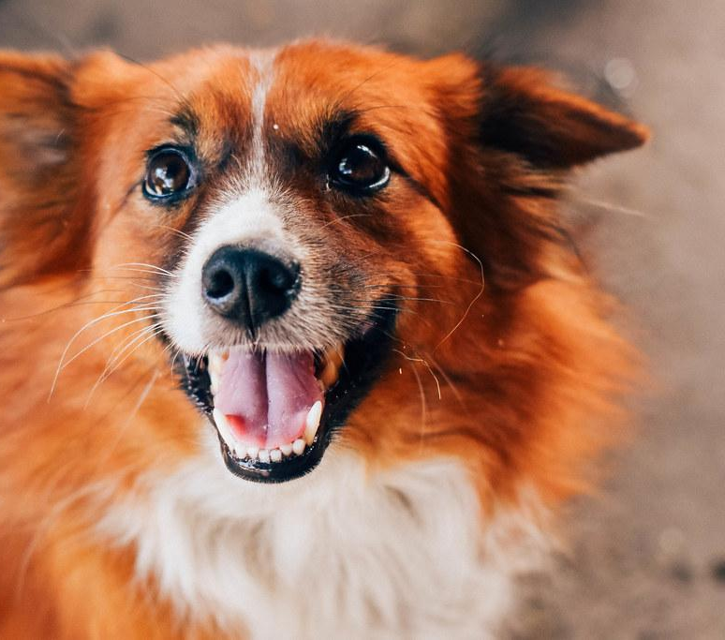
Professional Dogs

Slide 18
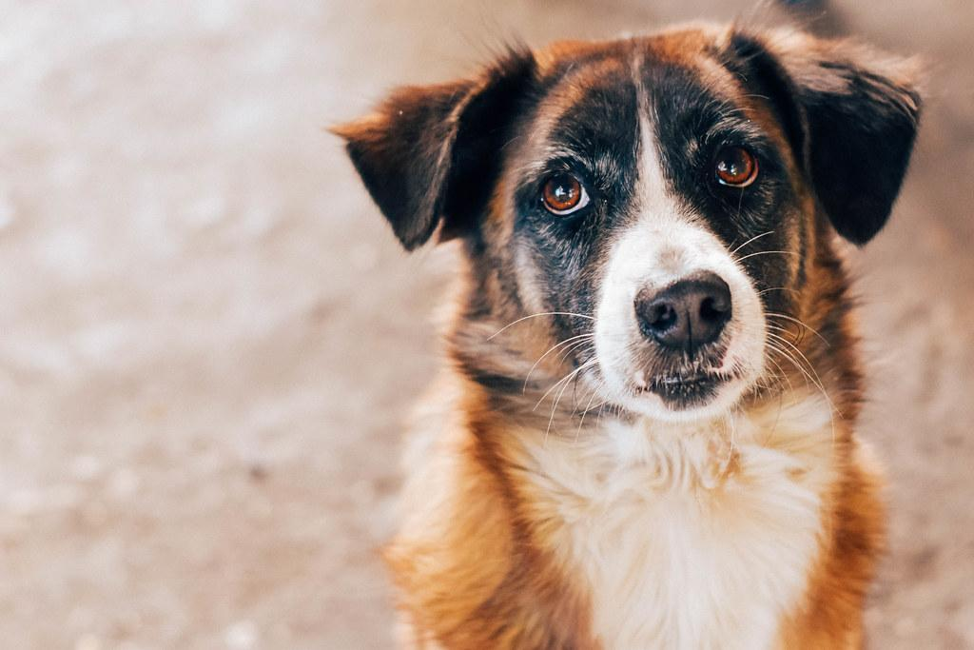
Judging
Appearance
Personality
Overall Wow-Factor

Slide 19
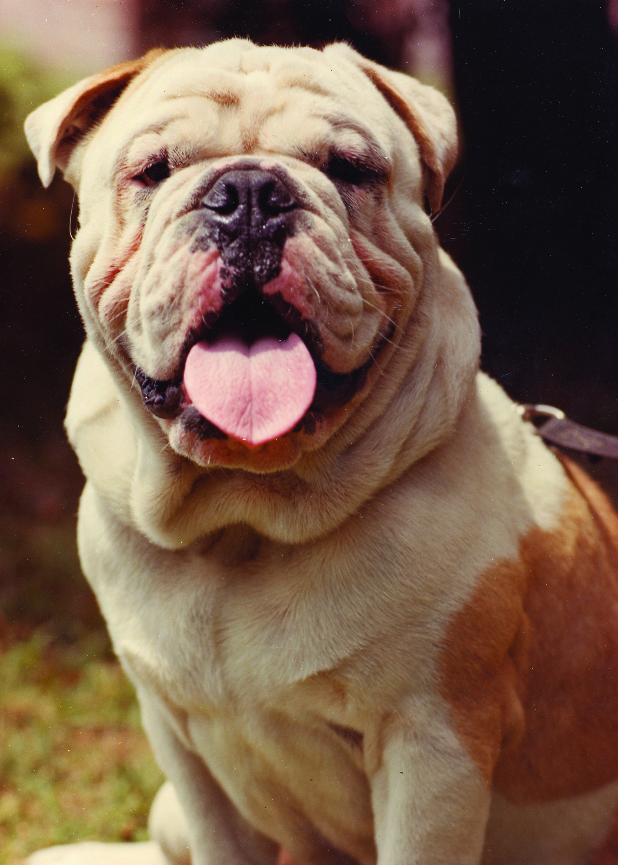
THOR
Best in Show
2019 National Dog Show
Likes to play & sleep
Active & Athletic
Can jump surprisingly high

Slide 20
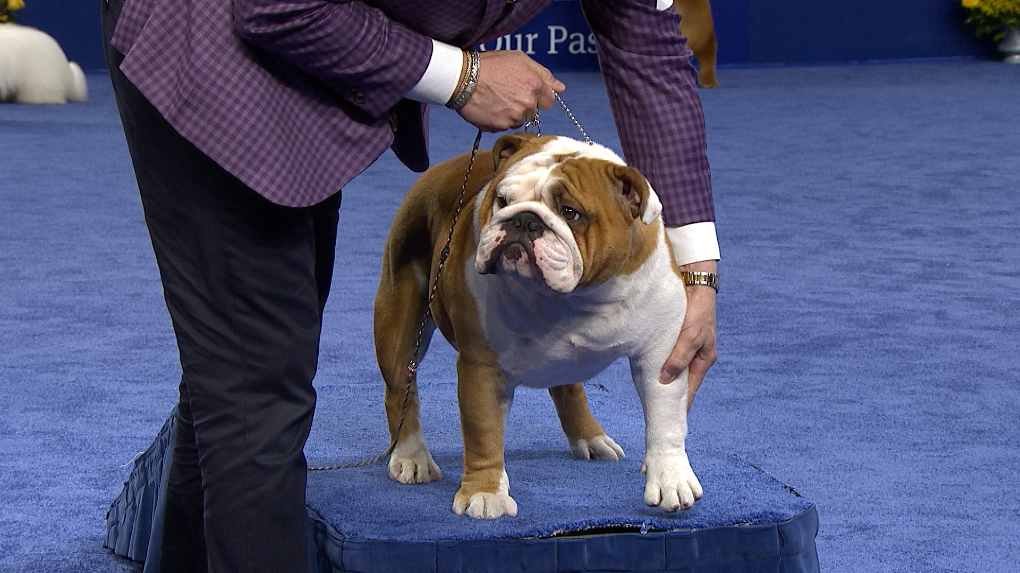
Bulldog, 2019 National Dog Show, Non-Sporting Group

Slide 21
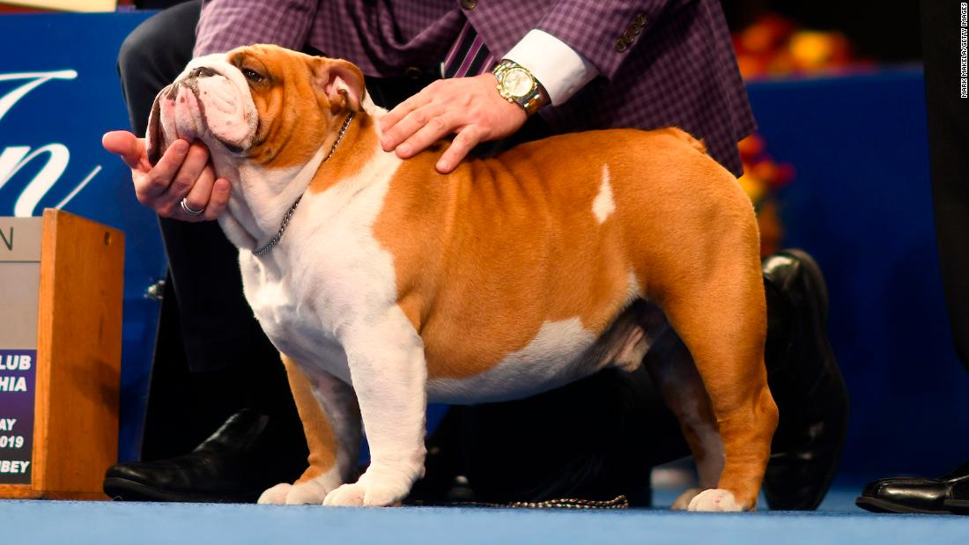
Your Turn
Appearance
Personality
Overall Wow-Factor

Slide 22
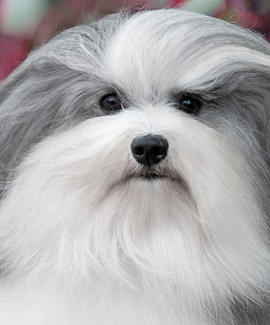
BONO
Toy Group Winner
2019 National Dog Show
Lives in California
2 years old
Friendly and outgoing

Slide 23
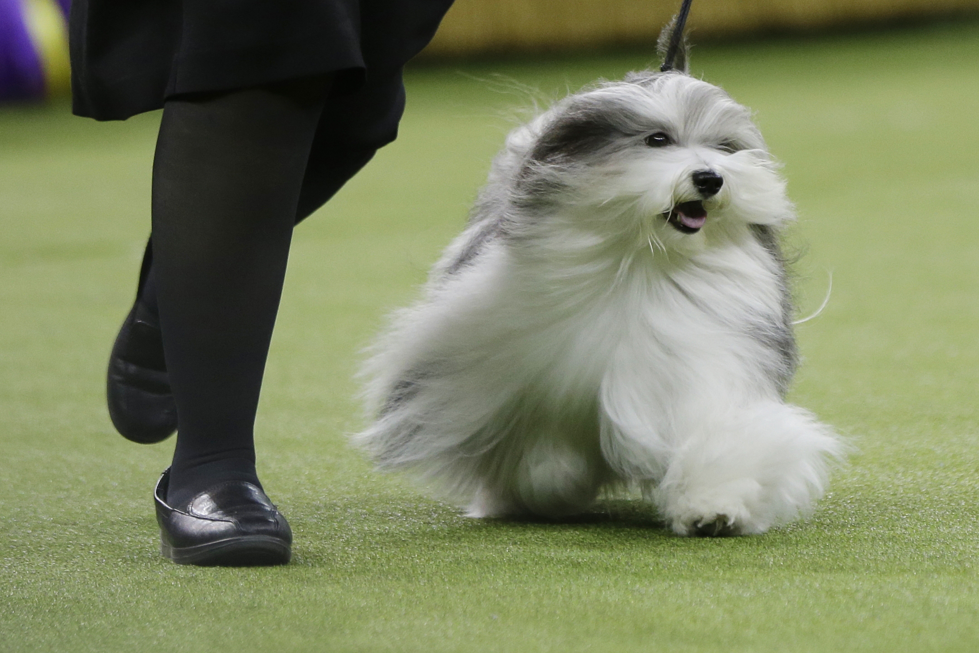
2019 National Dog Show Bono Havanese

Slide 24
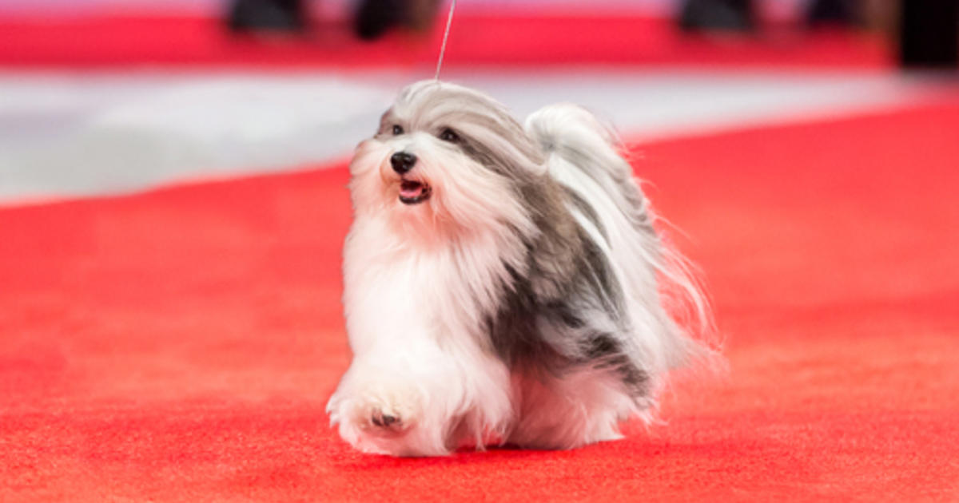
Your Turn
Appearance
Personality
Overall Wow-Factor

Slide 25
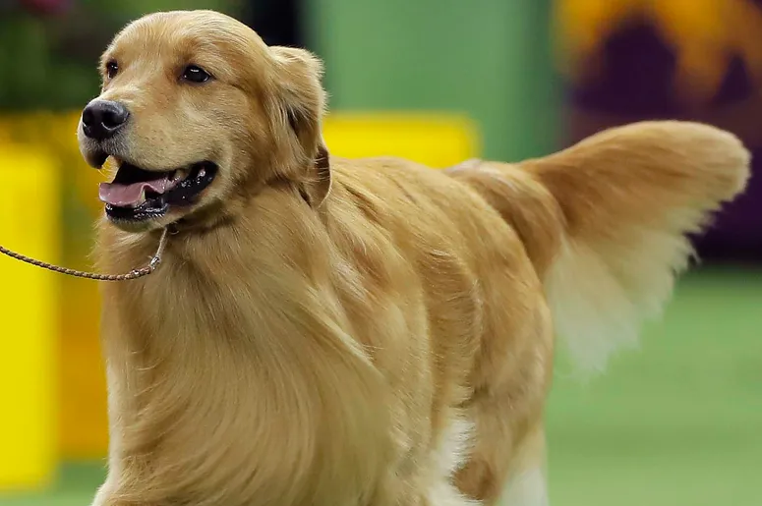
DANIEL
Sporting Group Winner
2019 National Dog Show
6 years old
Has title of CGC - Canine Good Citizen for his good manners and obedience

Slide 26
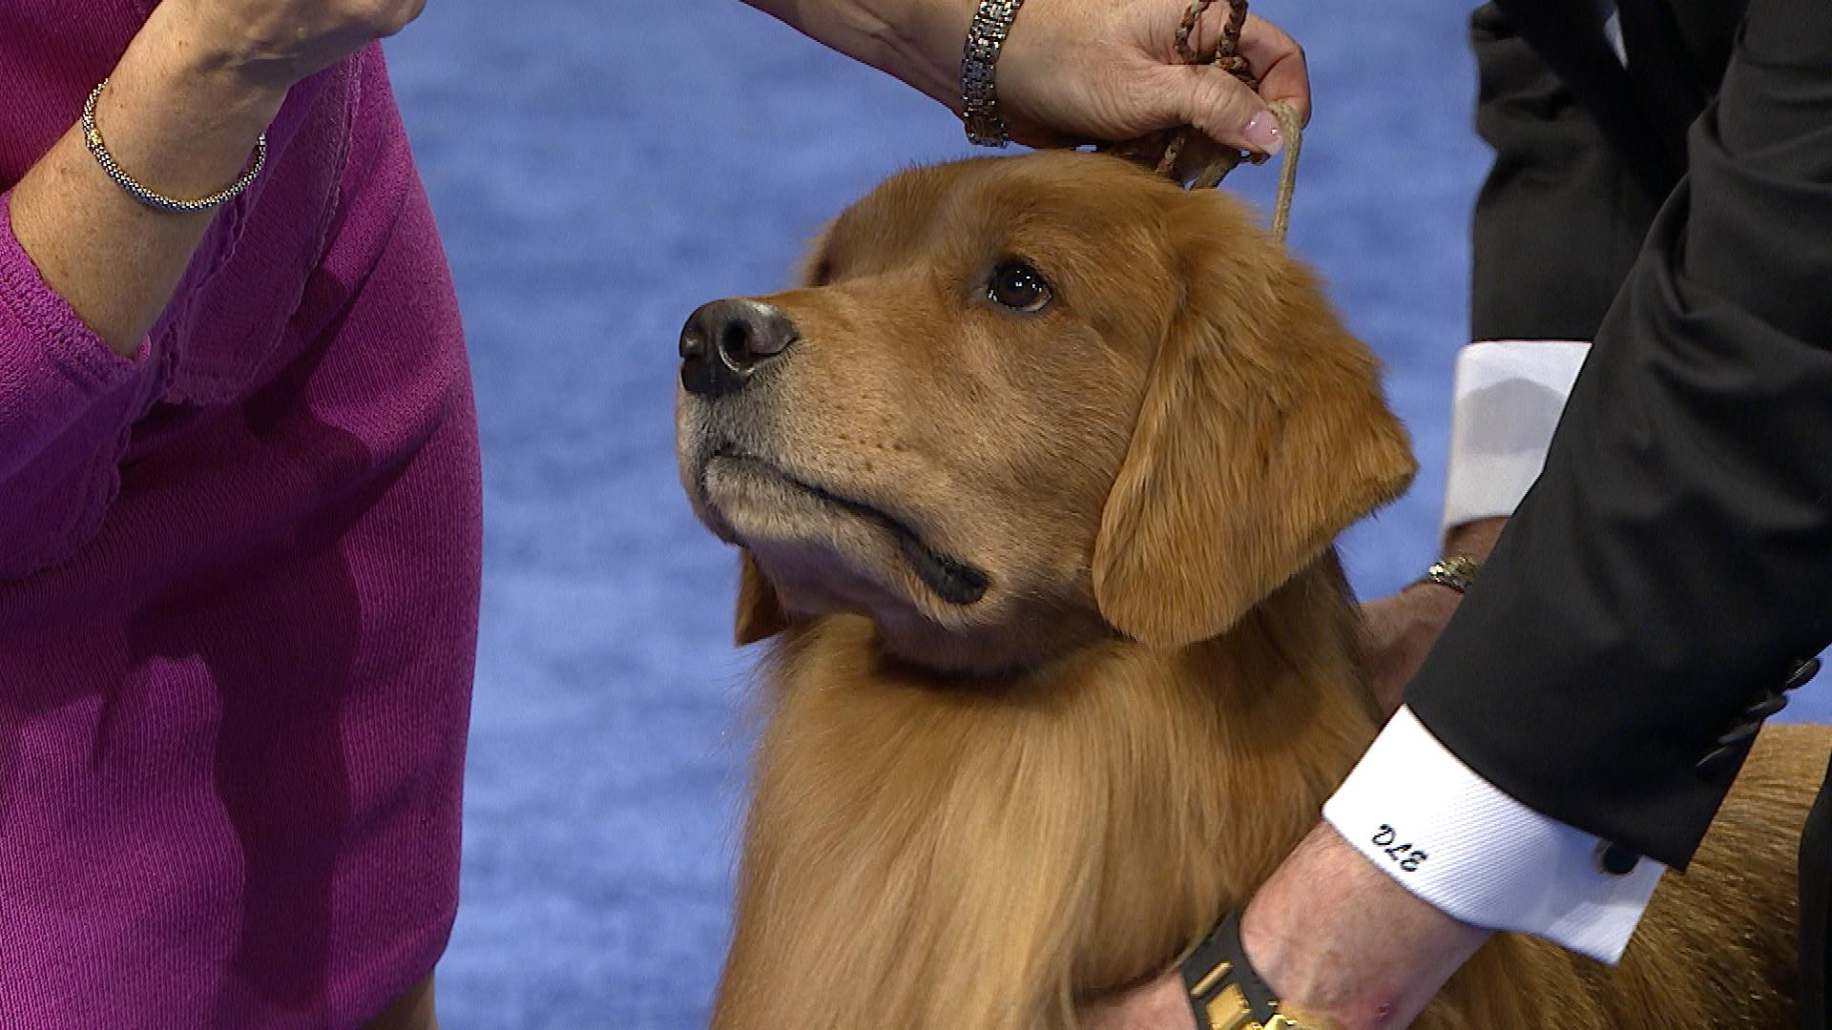
https://www.nbcsports.com/video/golden-retriever-2019-national-dog-show-sporting-group

Slide 27
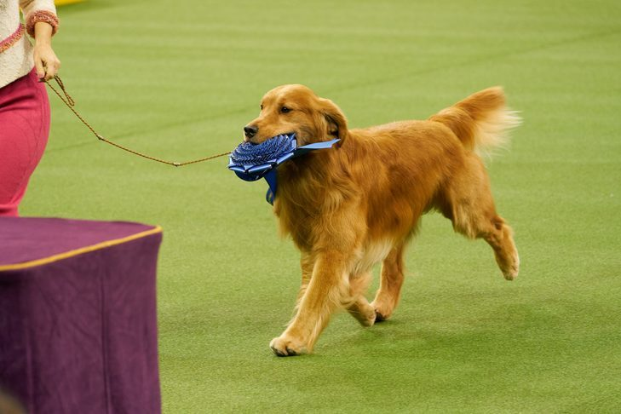
Your Turn
Appearance
Personality
Overall Wow-Factor

Slide 28
Who won Best in Show?
Thor
Bono
Daniel

Slide 29
Which country has the most pet dogs?

Slide 30
Highest Amount of Pet Dogs
Argentina, Mexico and Brazil are the countries with the highest amount of pet dogs per house

Slide 31
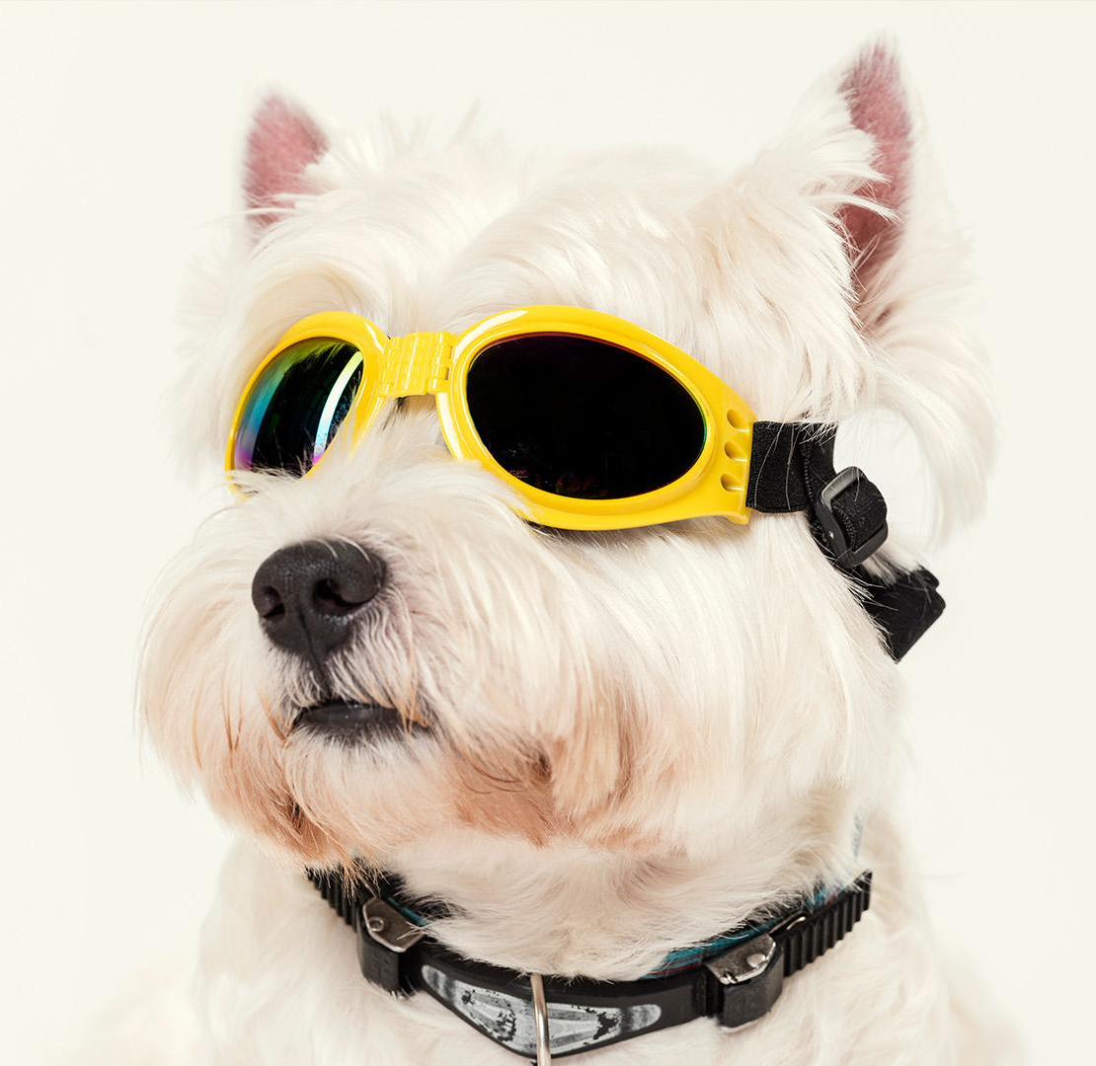
How to Keep your Pup Busy During Quarantine

Slide 32
Classic Games
Catch!
Fetch!
Water!
Throw a ball and let your dog catch it!
Toss an object and let your dog fetch it
Some dogs love water and being bathed

Slide 33
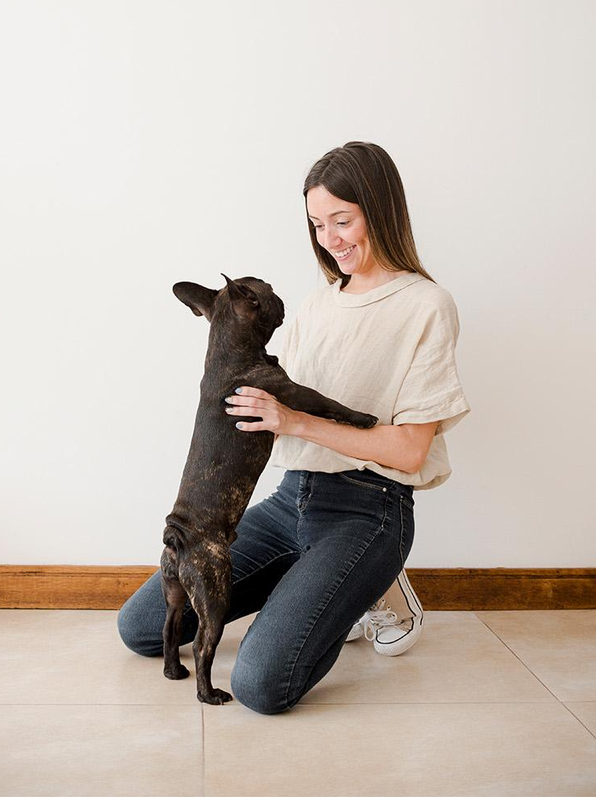
2. Hide-and-Seek
Play hide-and-seek with your dog to strengthen your emotional bonds and improve their finding skills

Slide 34
3. Find It!
Part 1
Part 2
Part 3
Classic
Heights
In the Dark
Show your dog a piece of food or a treat
Hide it somewhere and say ‘find it!’
Show the piece of food or treat
Hide it at a different level and say ‘find it!’
Show the piece of food or treat
Hide it somewhere, turn the lights off and say ‘find it!’

Slide 35
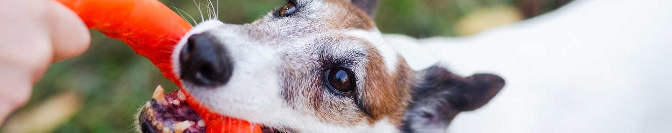
4. Tug-of-War
1
2
3
4
Grab a towel and tie some knots
Show the new towel-toy to your dog
Hold it firmly when your dog bites it
Keep playing until your dog gets tired

Slide 36
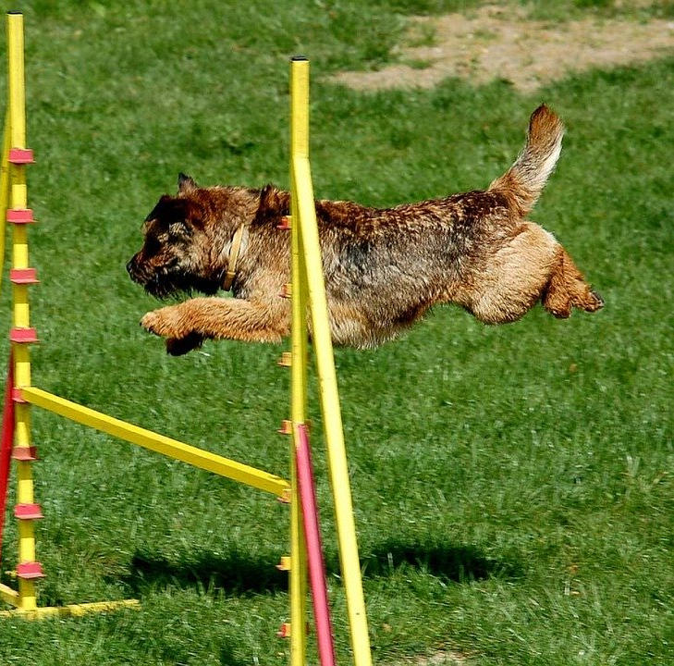
5. Agility Course
Try making an obstacle course for you and your dog!
Stool (to jump over it)
Chairs (to jump over them or pass underneath them)
Open cardboard boxes (to be used as tunnels)
Stick (to jump over it)
Maze with cardboard boxes (for small dogs)
Board (to cross between chairs)
Ramp (to go up)
Ball (to push it)
Hula-hoop (to go through it)
Don’t forget to give some treats to your dog!

Slide 37
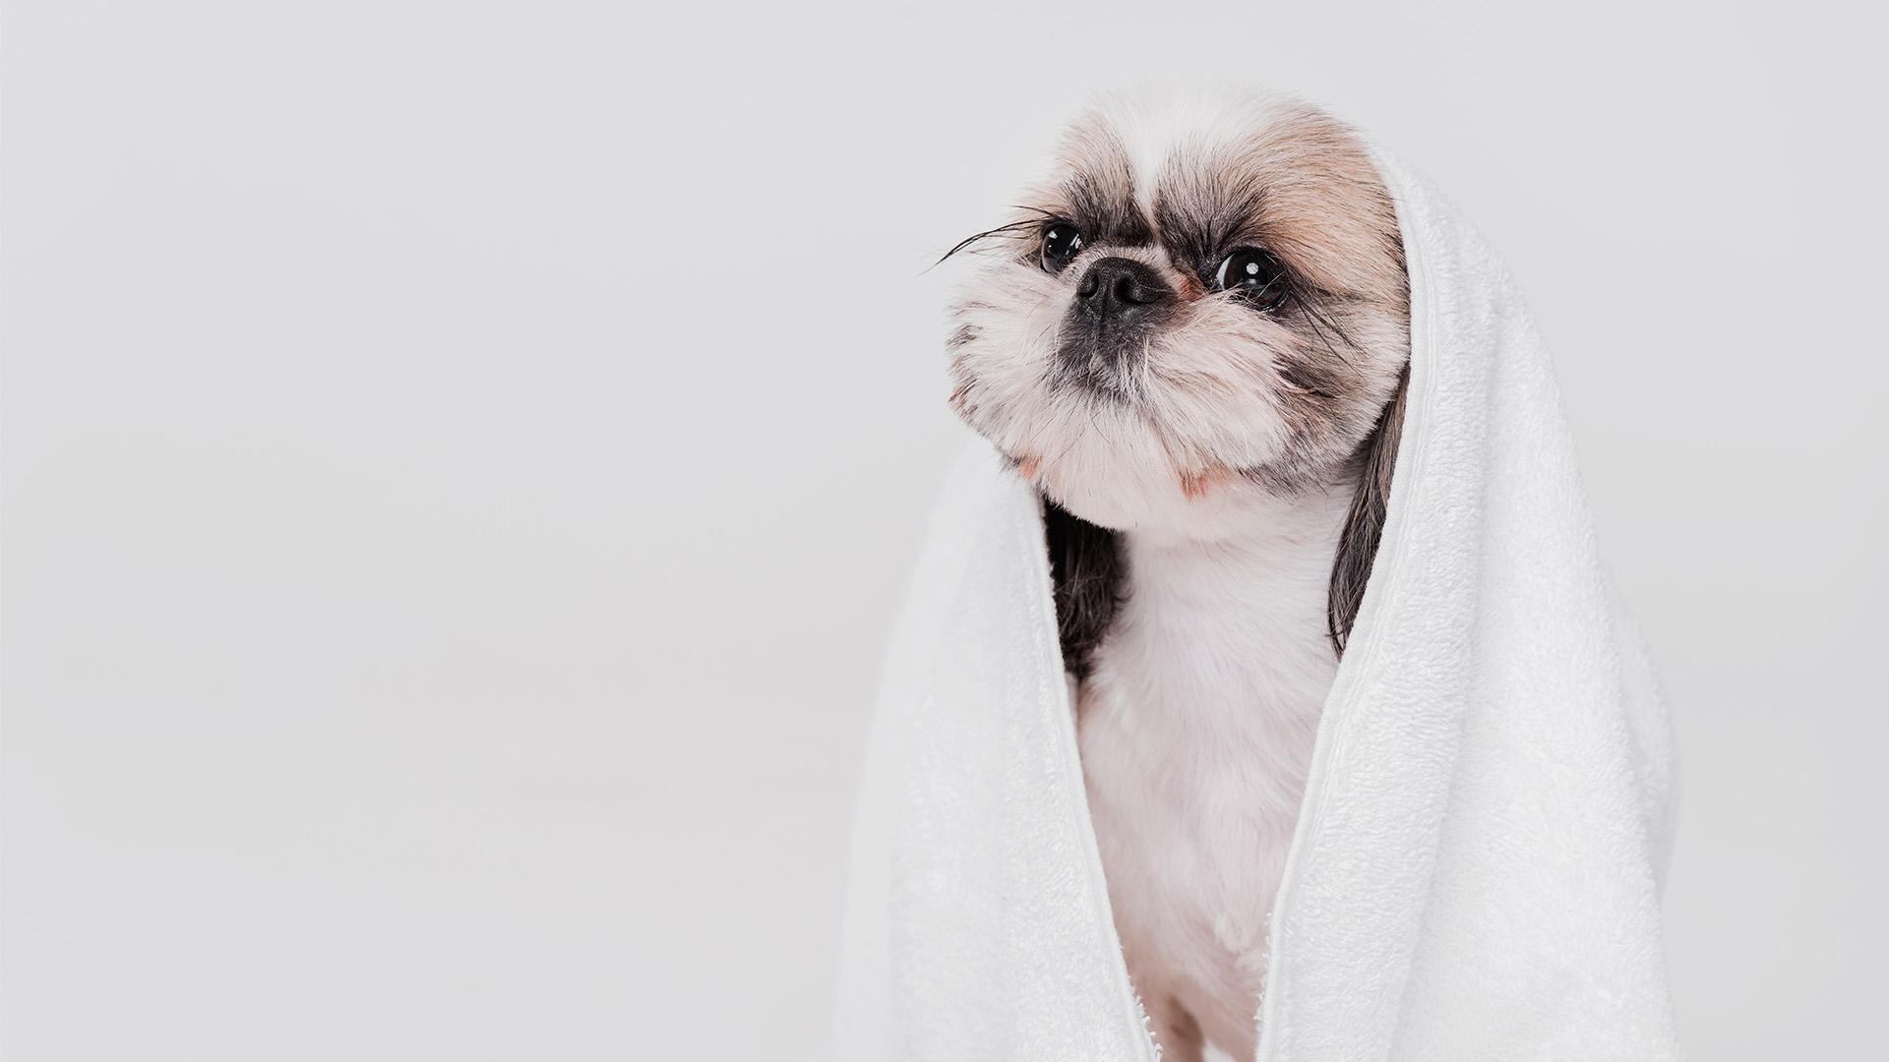
6. Relax Time
Music therapy
Doga
Using music as a mental stimulation to reduce stress levels
Practicing yoga with your dog to strengthen emotional bonds and improve its mood

Slide 38

7. Technology
You can watch a movie together (especially if dogs are featured on it), listen to a relaxing playlist (to calm your dog down) or a lively one

Slide 39
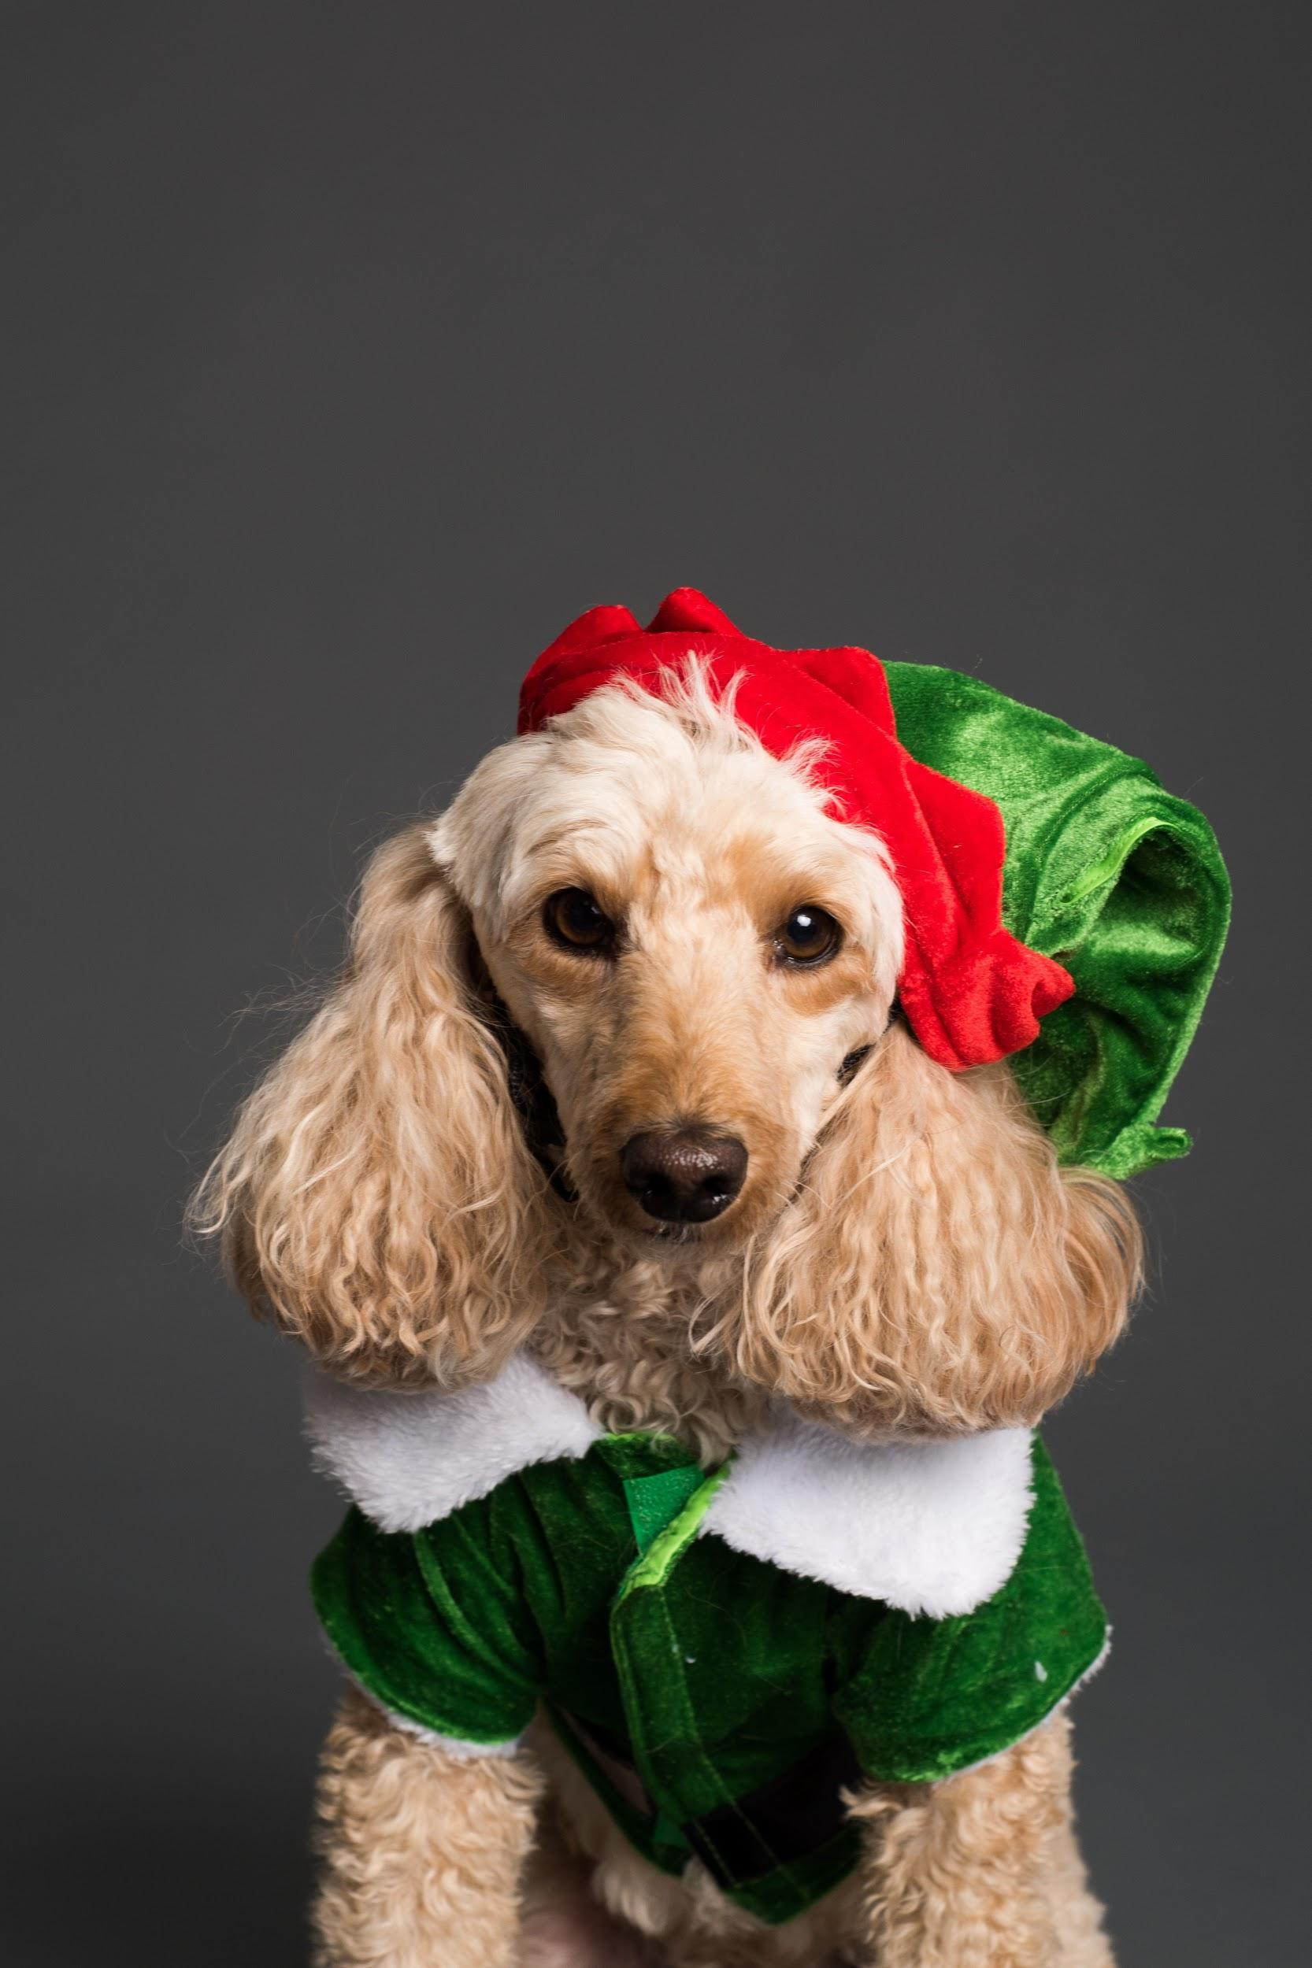
8. Dress up
To have a fun time, you can dress up your dog, take lots of pictures of you two together and share them on social media

Slide 40

Great Job
Have fun with your pups!

