Slide 1
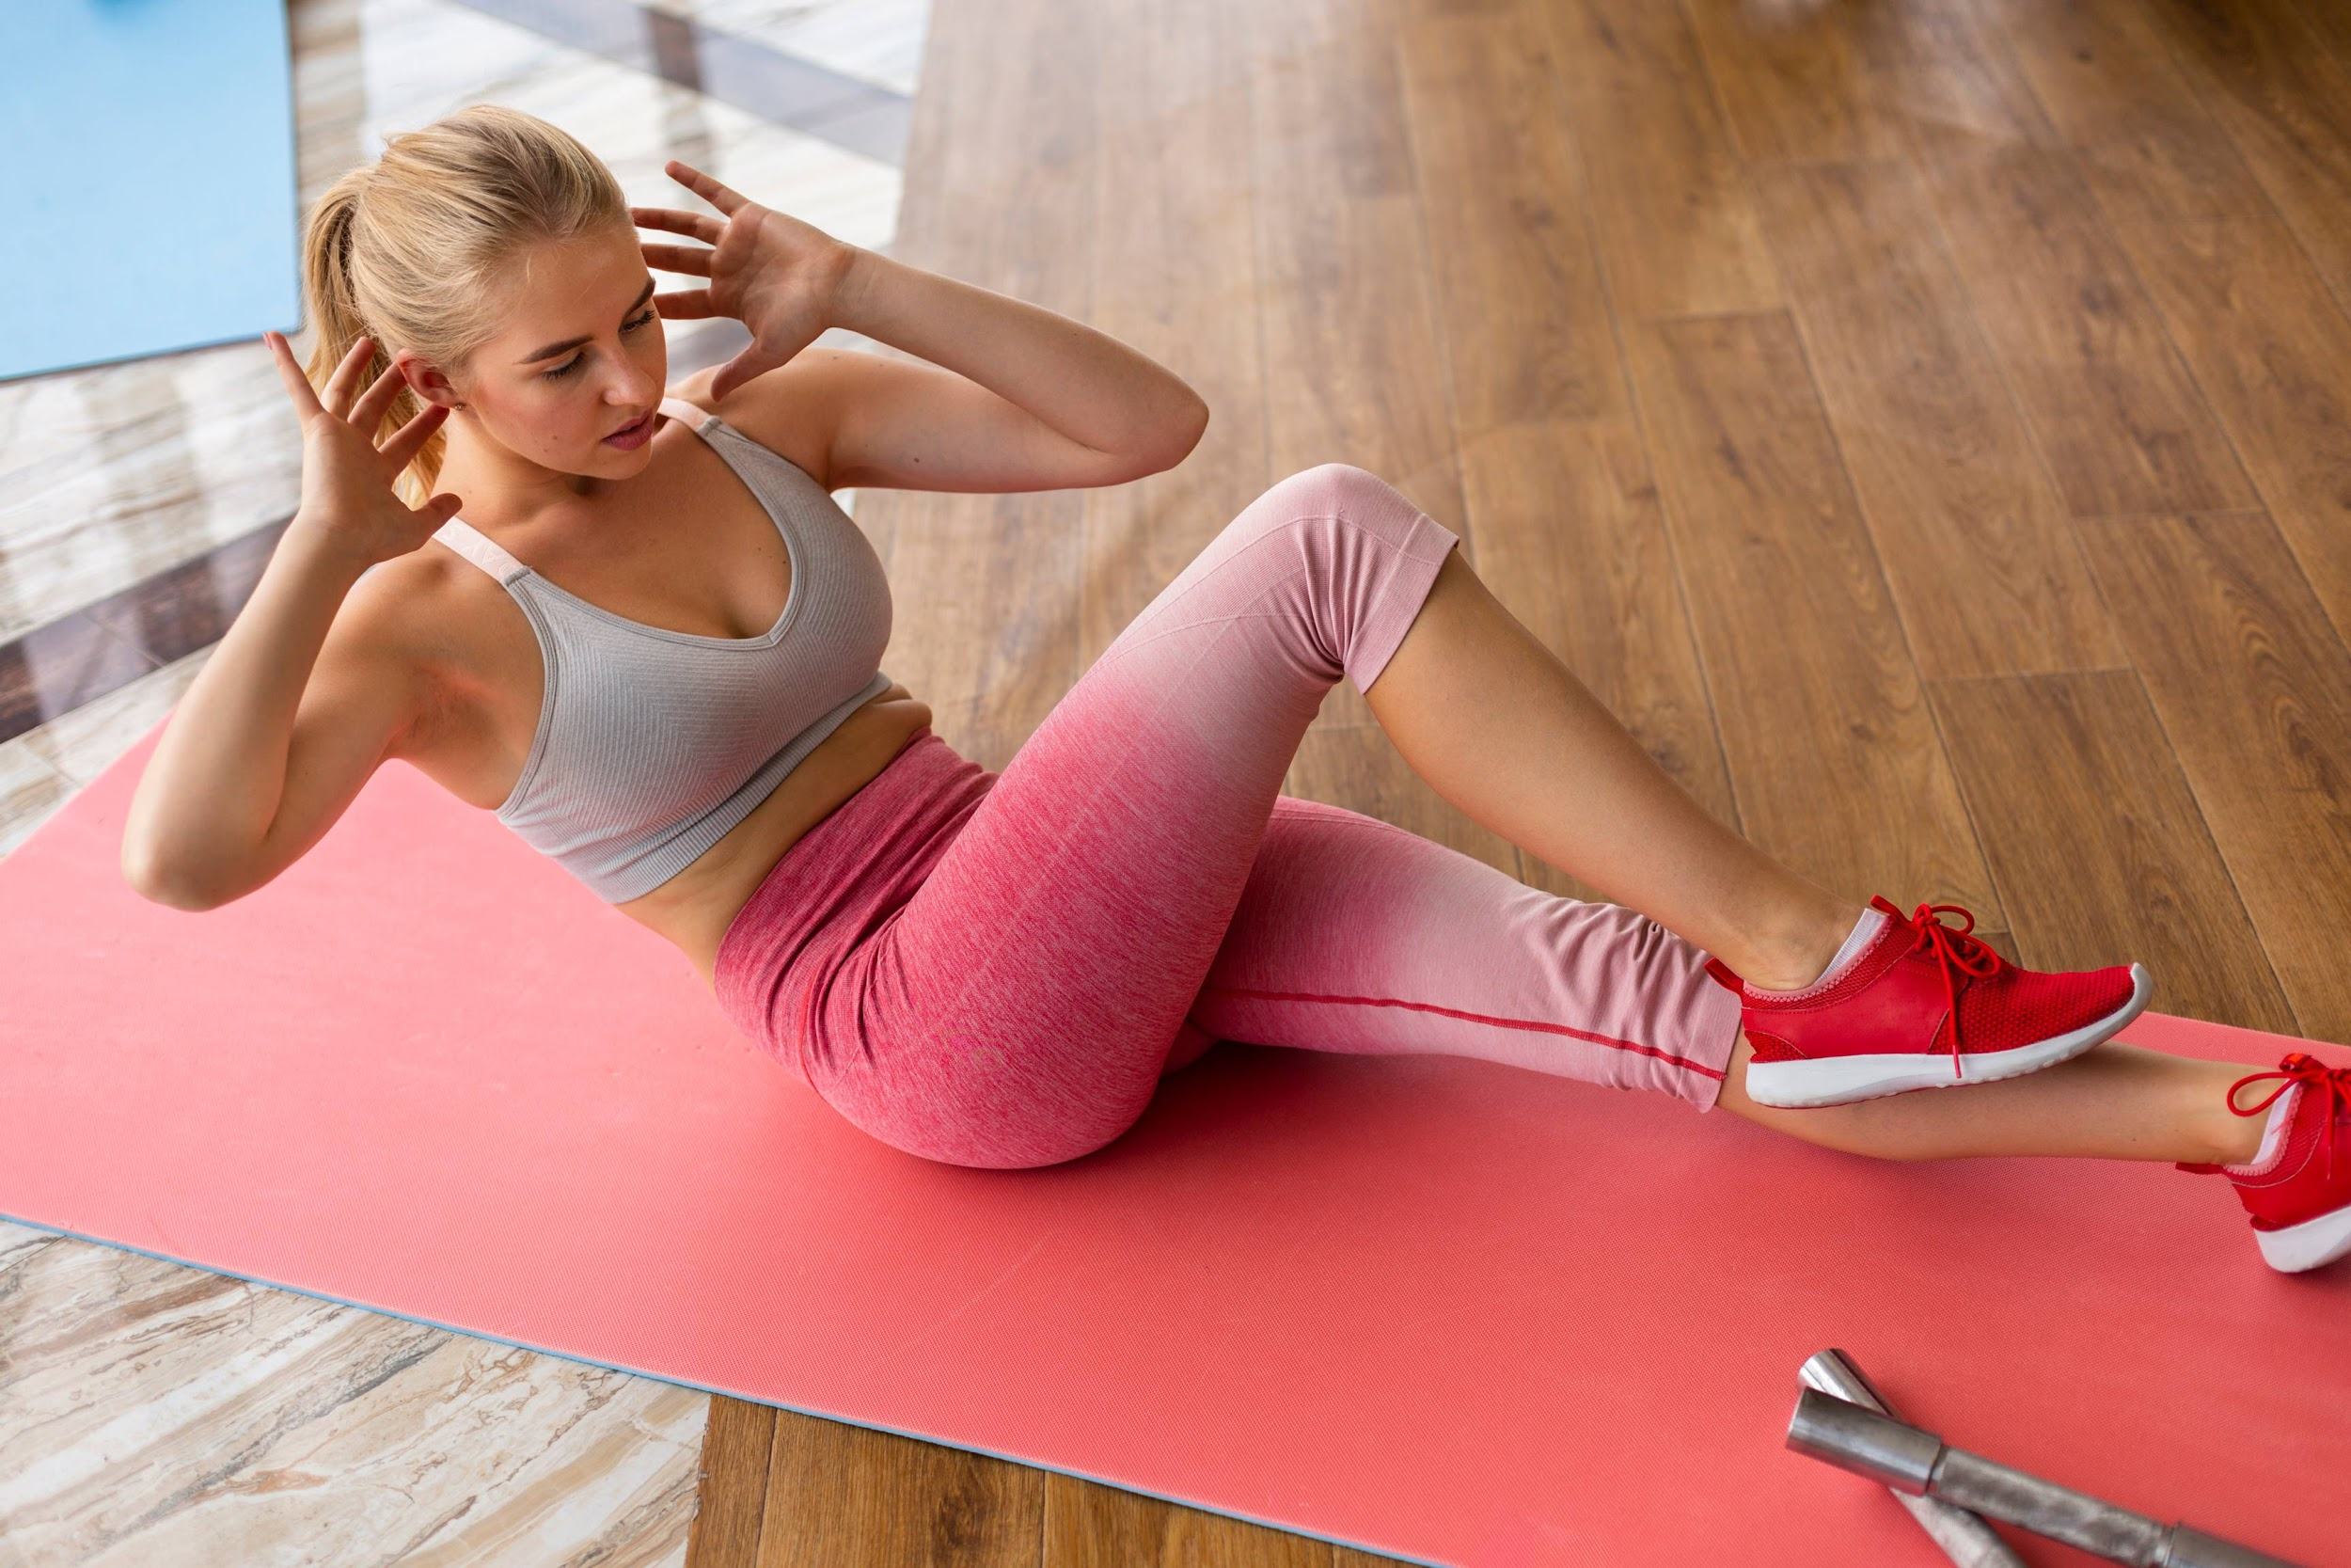
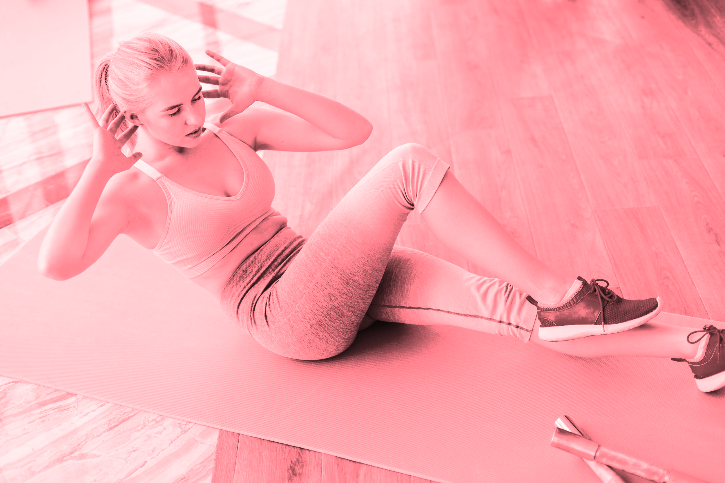
WORKOUT EDUCATION

Slide 2
Physical Fitness
This is a general state of health and well being.
This gives us the ability to perform aspects of sports, occupations and daily activities.
This is generally achieved through proper nutrition, moderate-vigorous physical exercise, and sufficient rest
Do not sit to long.

Slide 3
At least how long should the warm-up in your physical fitness training last?
5-10 minutes
10-15 minutes
20-25 minutes
A
B
C

Slide 4
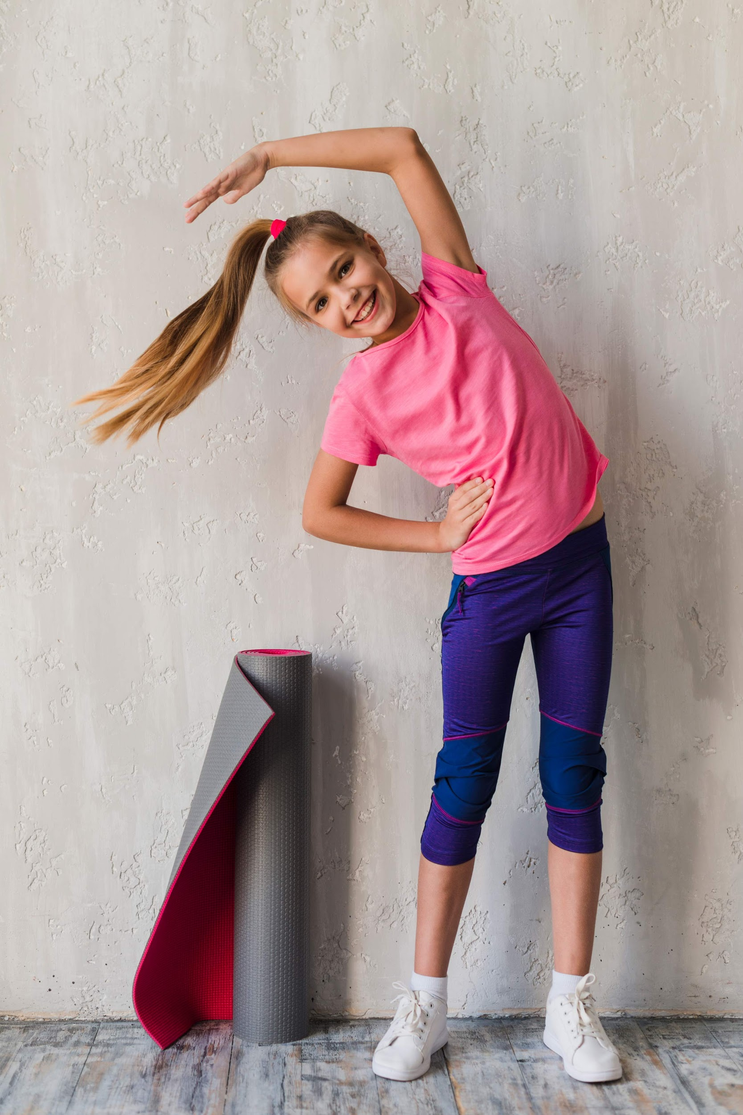

Stretches
-arms above head
-touch toes
-R arm across chest/L arm across chest
-arm circles forward/backward
-R arm over head/L arm over head
-Jumping jack

Slide 5
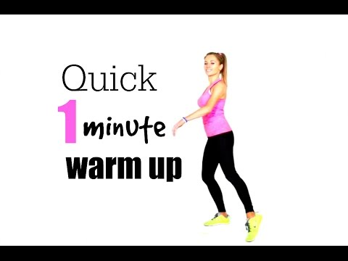
Warm up

Slide 6
Extending a joint Beyond its normal anatomical position is called what?
Hyperextension
Hypoextension
Fracture
A
B
C

Slide 7
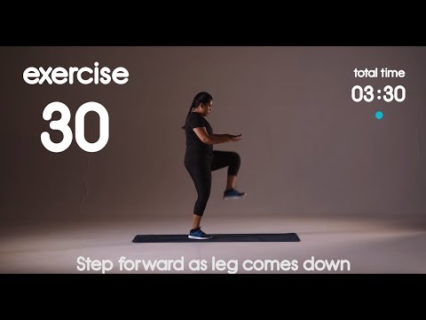
Cardio

Slide 8
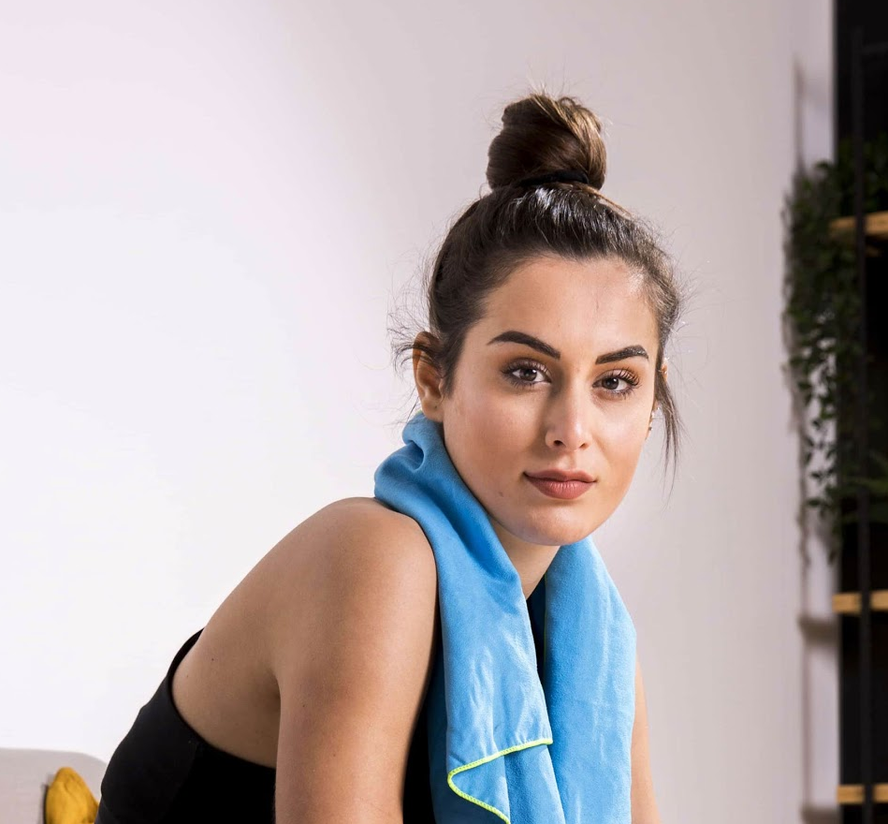
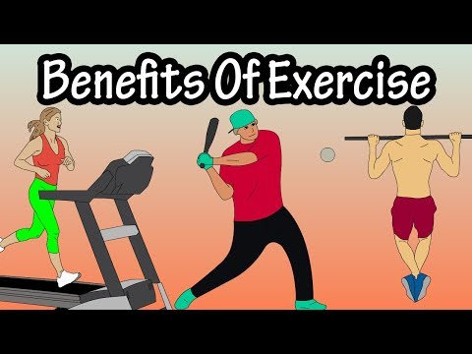



Benefits of Physical fitness

Slide 9
What is the scientific study of human movement?
Psychology
Anatomy
Kinesiology
A
B
C

Slide 10
What is the rate at which you burn calories ?
Systolic rate
Metabolic rate
Diastolic rate
A
B
C

Slide 11
What is the natural feel good chemicals?
Endorphins
Cortisol
Metabolism
A
B
C

Slide 12
Exercise can also improve...
Sleep
Brain function and self esteem
All of the above
A
B
C

Slide 13
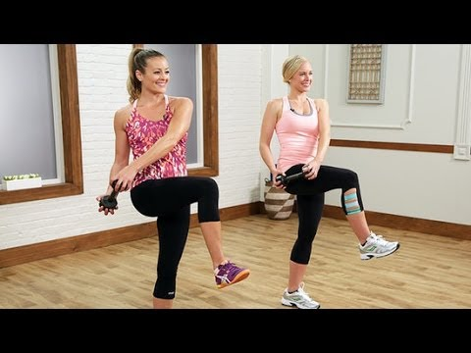
Ab Workout

Slide 14
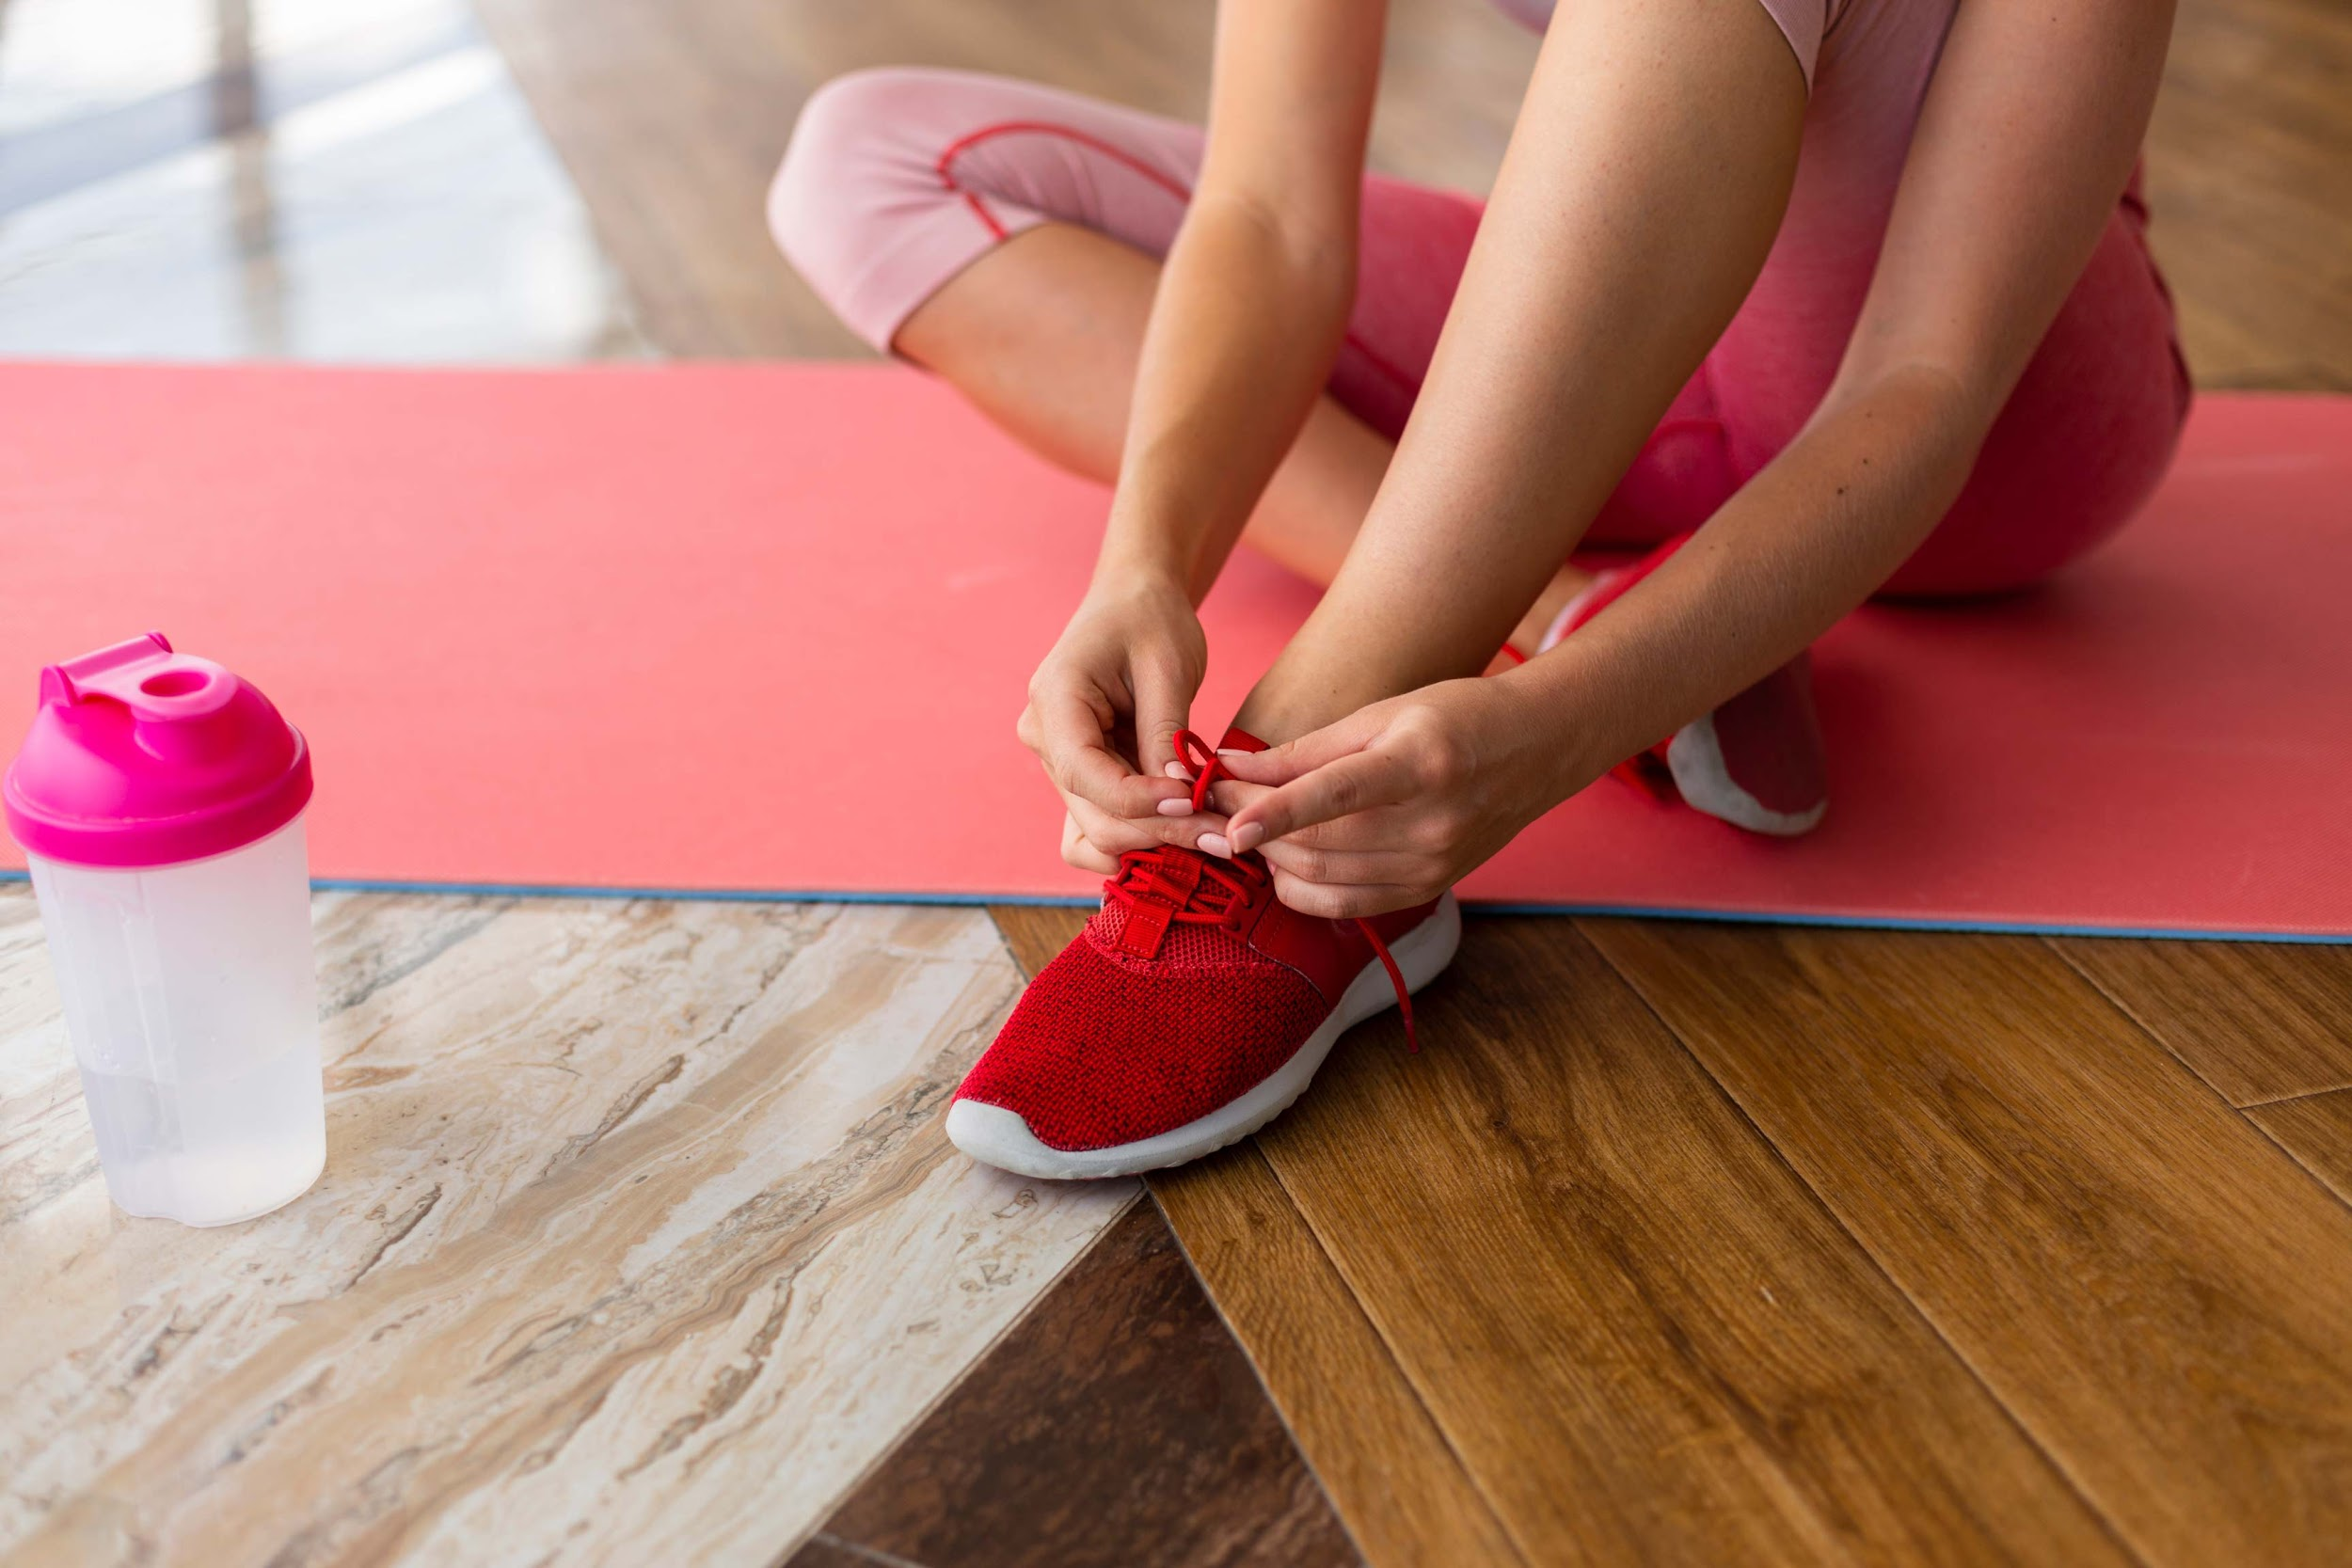
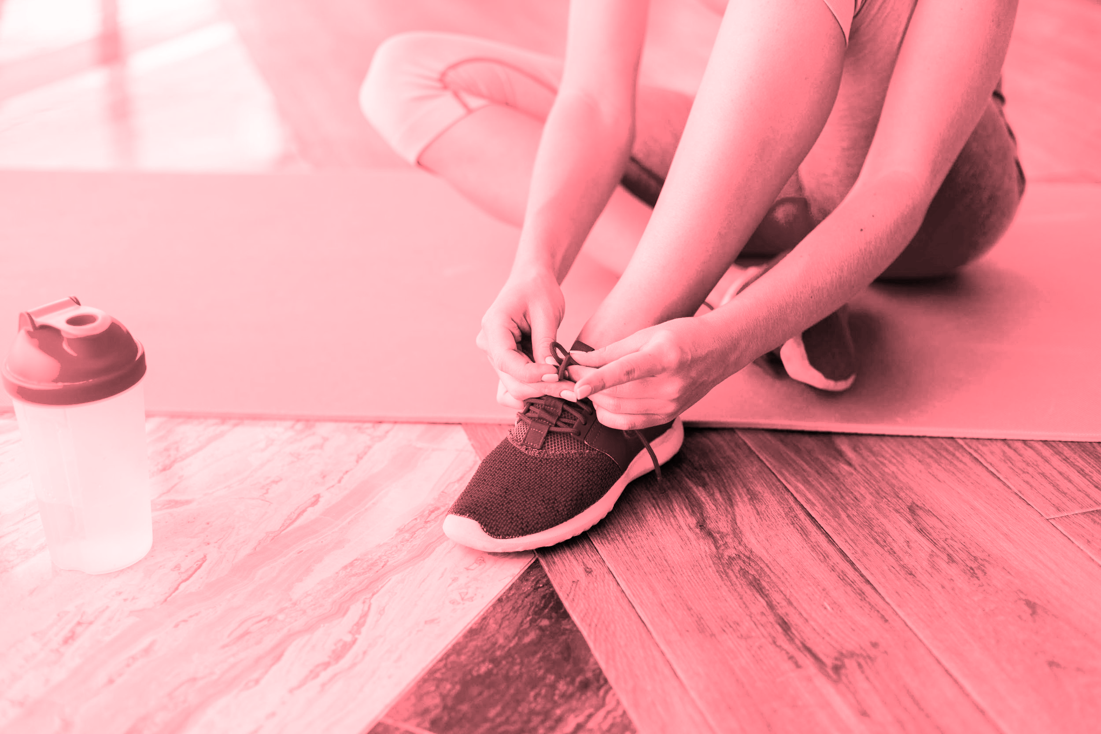
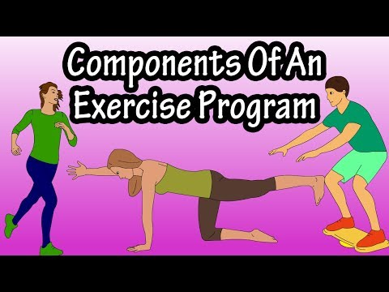
Exercise programming

Slide 15
Considering people's goals, restrictions, and limitations is part of?
A complete exercise plan
A comprehensive exercise plan
A partial exercise plan
A
B
C

Slide 16
Cardiorespiratory fitness is also known as?
Heart fitness
Air fitness
Aerobic fitness
A
B
C

Slide 17
Muscular fitness is also referred to as?
Resistance training
Muscular Strength
Muscular endurance
A
B
C

Slide 18
How long should you wait between strength training session?
20 hours
48 hours
72 hours
A
B
C

Slide 19
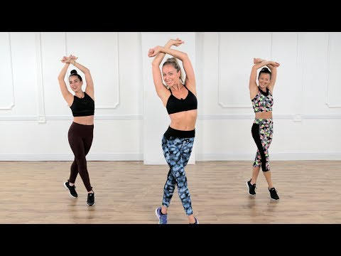

Slide 20
Flexibility is enhanced by the daily performance of ?
Sleeping well
Staying hydrated
Stretching exercises
A
B
C

Slide 21
Stretching after a workout helps to accomplish what?
Relax strained muscles
Increased happiness
Fix a torn muscle
A
B
C

Slide 22
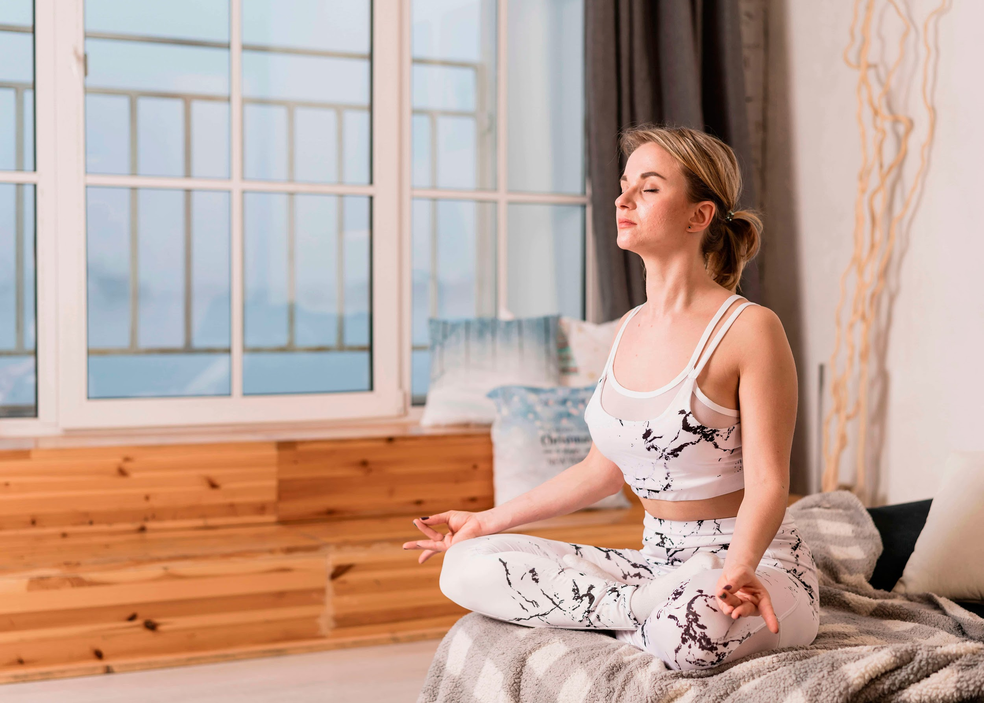
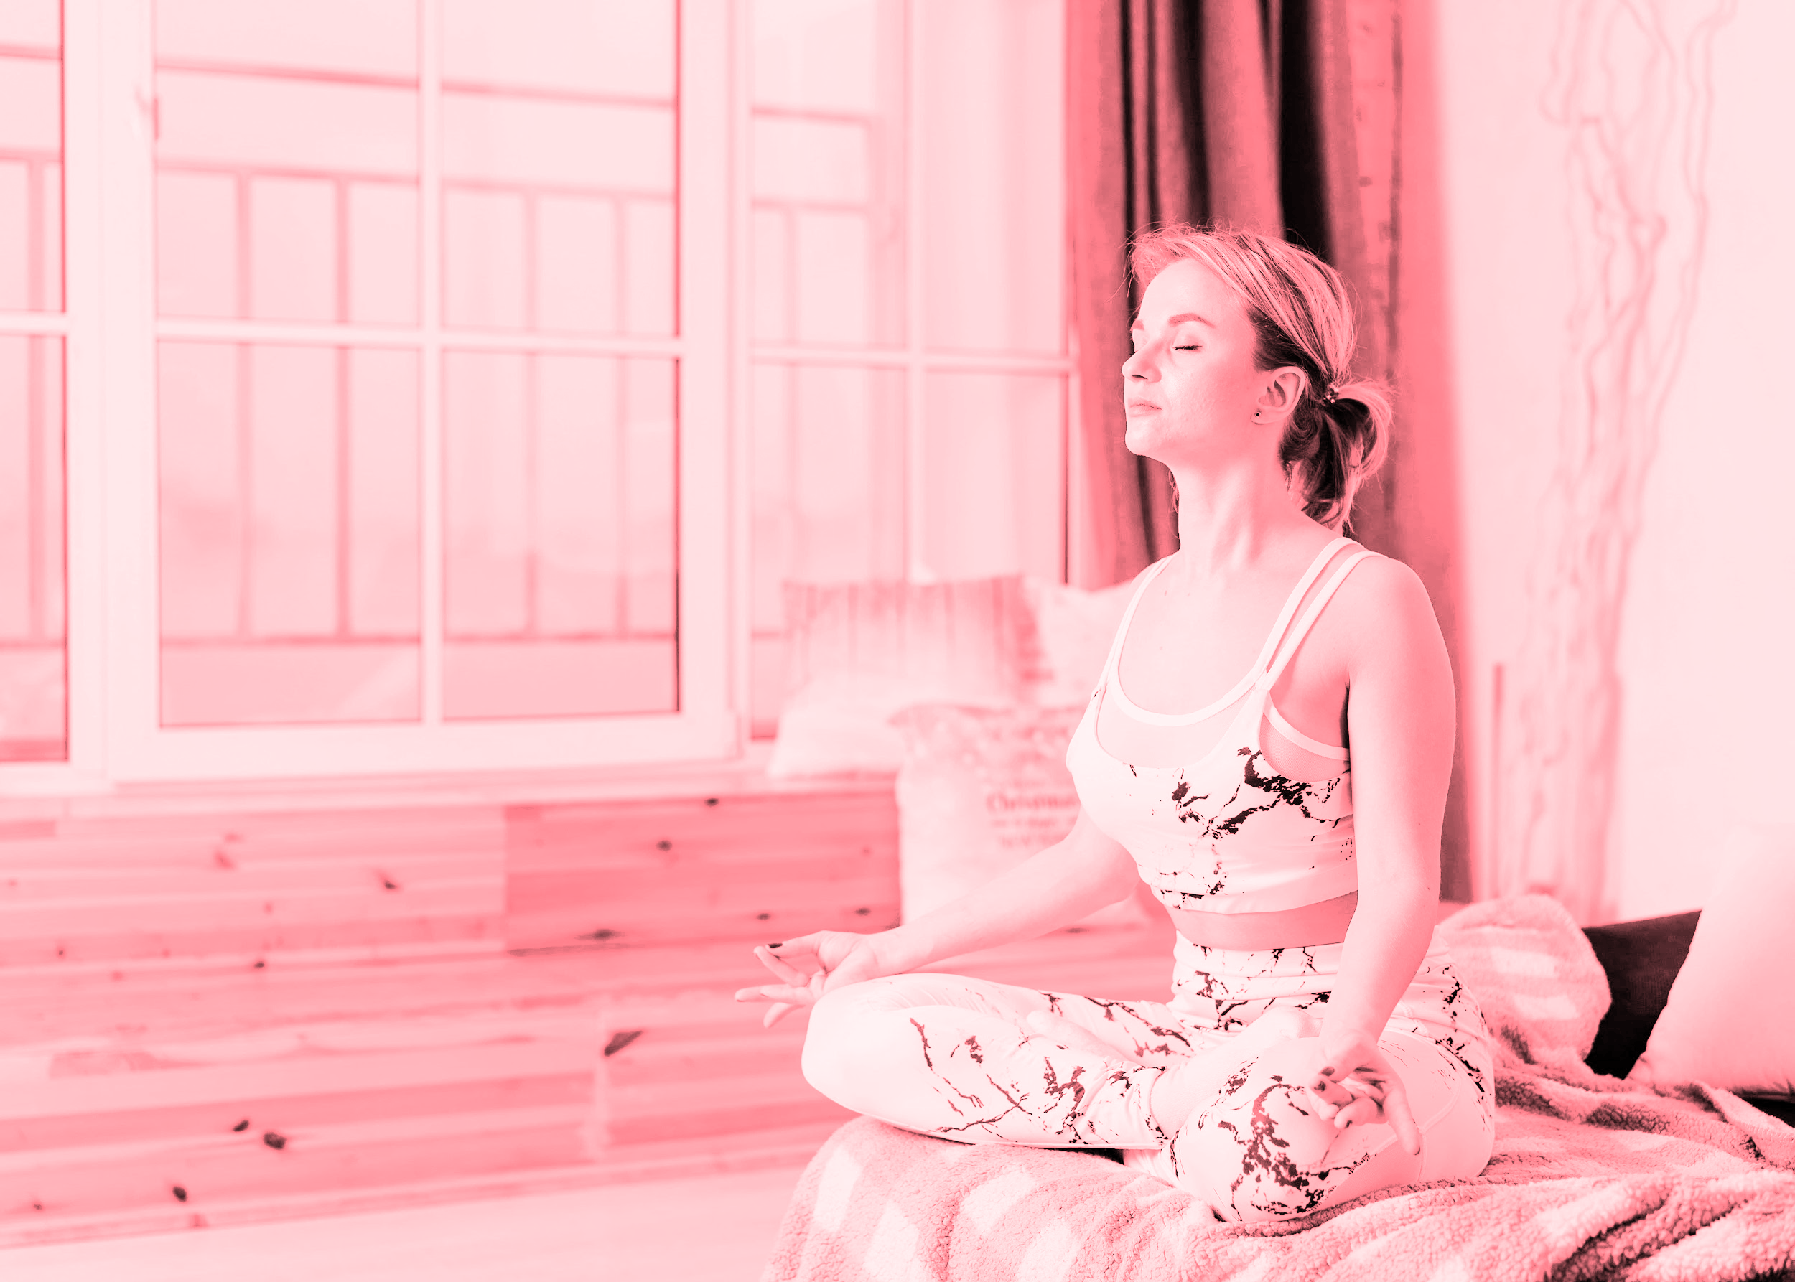
Benefits of cooling down
Cooldown exercises start the recovery process.
A gradual cooldown keeps your blood circulating.
It allows your body temperature, blood pressure, and heart rate to return to their normals level.

Slide 23
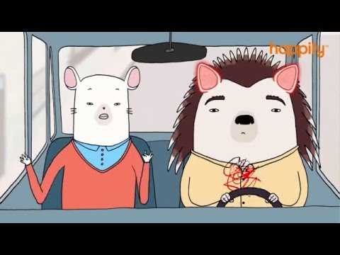
Mindfulness

Slide 24
Cool Down
Seated forward bend
Knee-to-chest pose
Standing quadriceps stretch
Standing forward bend
Shoulder stretch
Marking arm circles
Body shake
Corpse pose
https://www.healthline.com/health/exercise-fitness/cooldown-exercises#for-kids

Slide 25
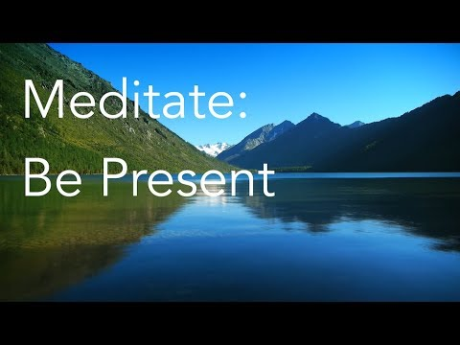
Meditation

Slide 26
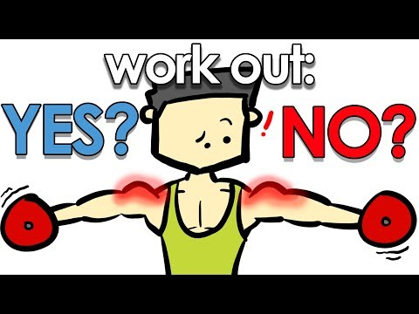
Being sore

Slide 27
What does DOMS mean?
Don’t order McDonald’s specials
Delayed onset muscle soreness
Donuts only make smiles
A
B
C

Slide 28
Working out sore can?
Worsen soreness
Hurt gains
It’s proven to worsen soreness or hurt gains
A
B
C

Slide 29
High soreness usually mean?
Low performance
No performance
High performance
A
B
C

Slide 30
Can you work out when your sore?
No
Yes
A
B

Slide 31
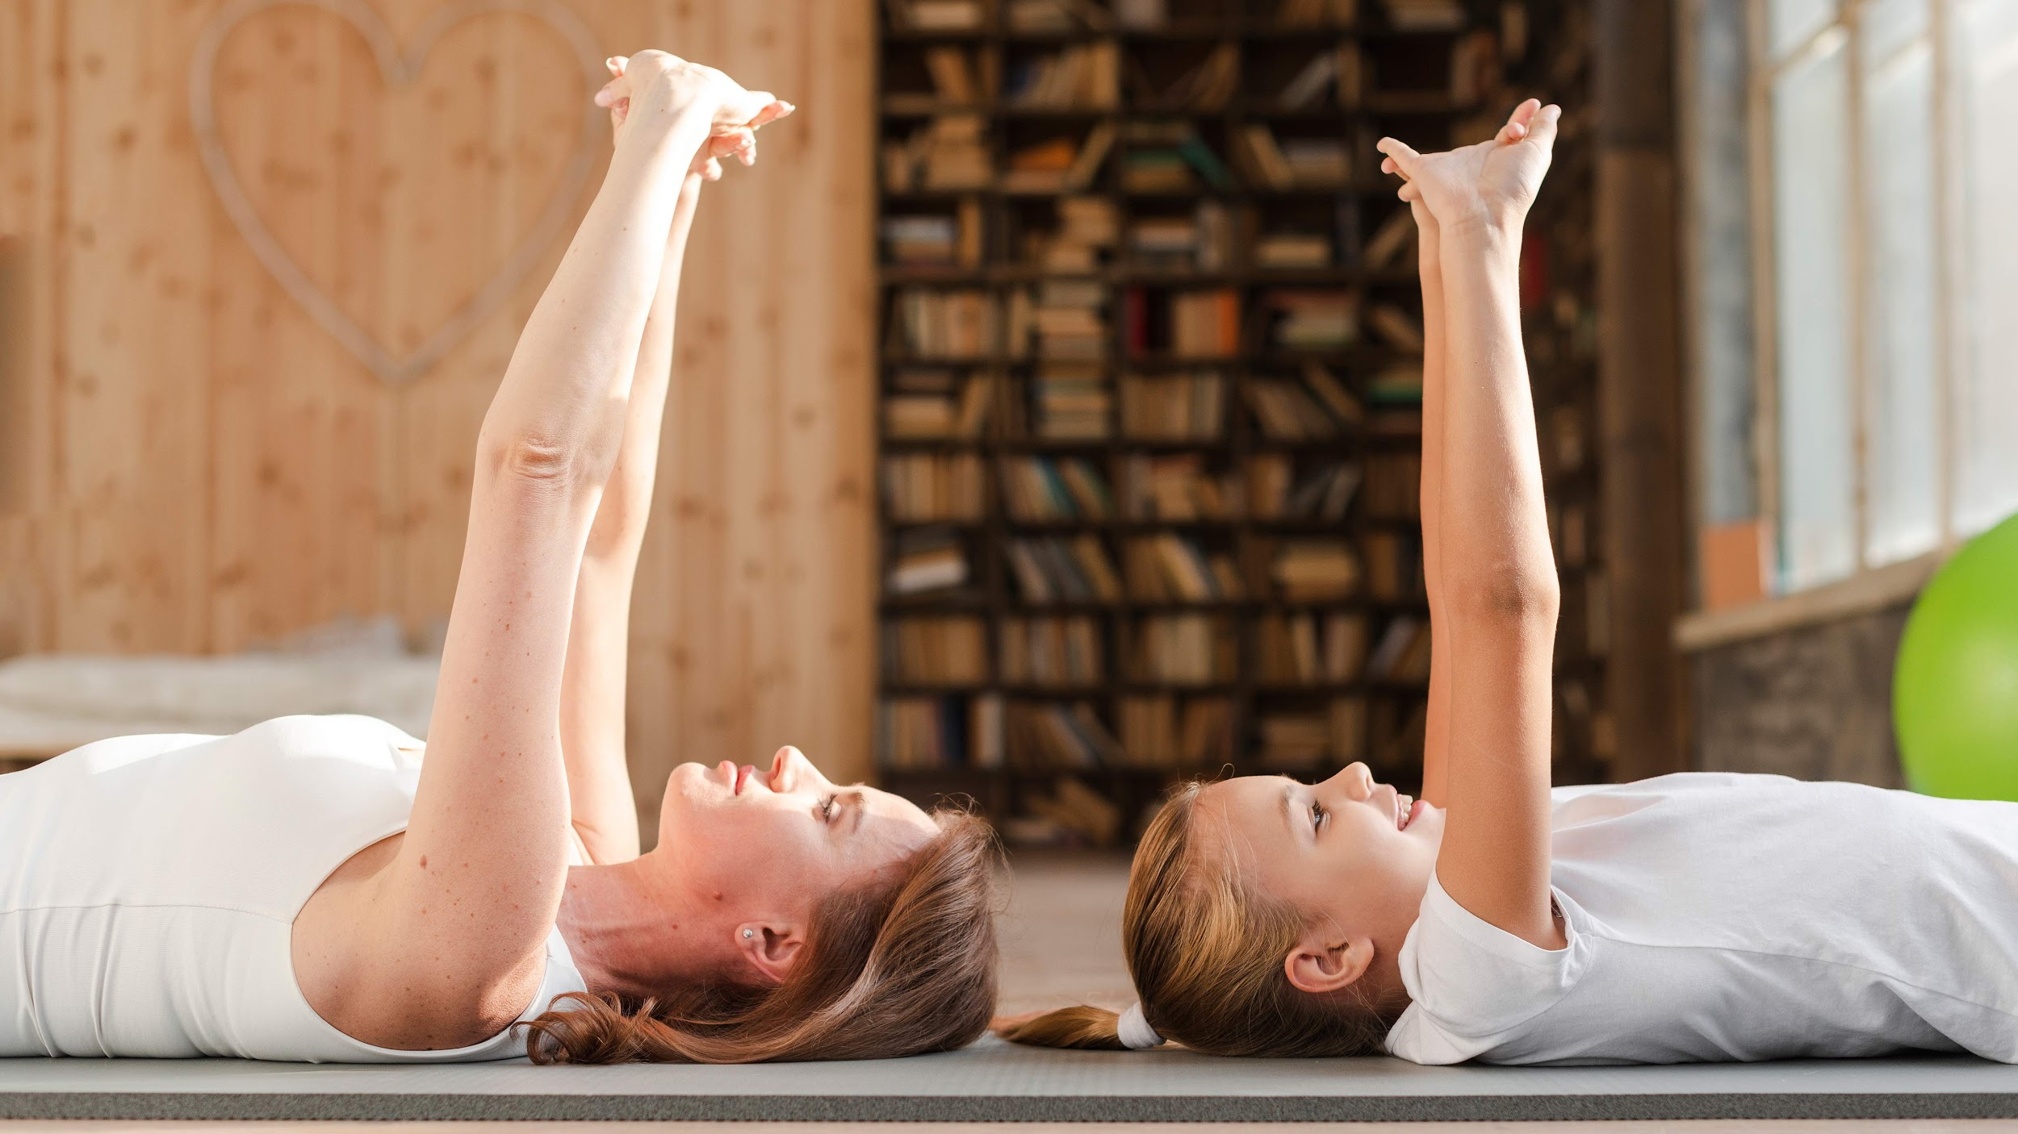
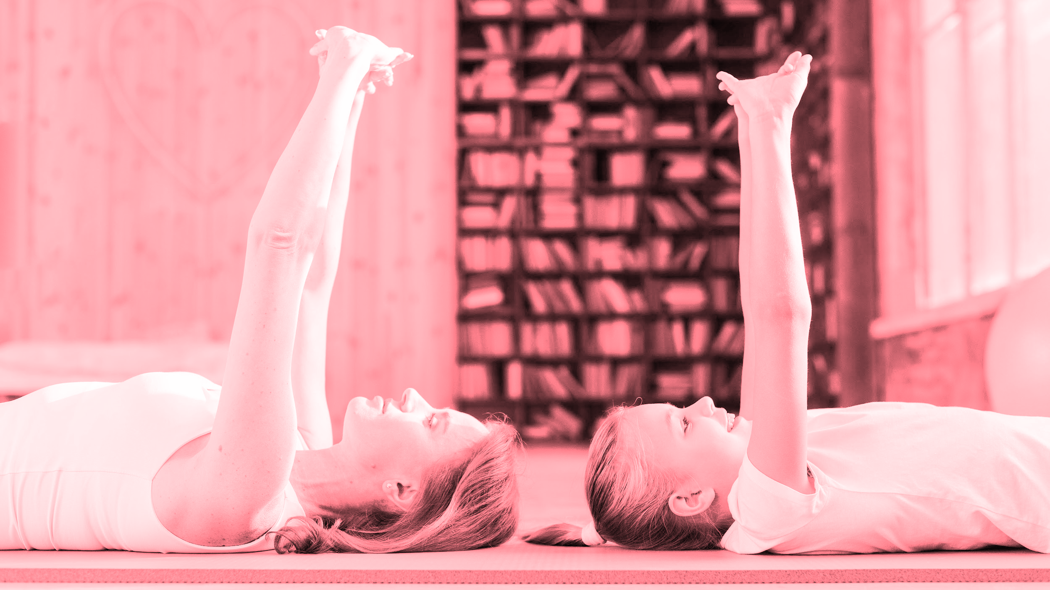
Thanks for joining us!

