Slide 1
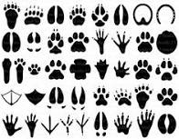
Animal Tracks Game

Slide 2
Instructions
Use the animal track explorer page to help identify the pictures of animal tracks and learn some fun facts about each animal.

Slide 4
TURKEY!

Slide 6
SKUNK

Slide 8
RACCOON

Slide 10
SQUIRREL

Slide 12
COYOTE

Slide 14
PORCUPINE

Slide 16
DEER

Slide 18
RABBIT

