Slide 1

Sign Language Practice

Slide 2
Video Clip 1
https://youtu.be/kK42LZqO0wA

Slide 3
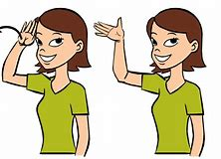
Hello

Slide 4
Practice time!

Slide 5
Video Clip 2
https://youtu.be/sQgd6MccwZc

Slide 6
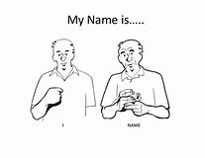
My name is ______________________

Slide 7
Practice time!

Slide 8
Video Clip 3
https://youtu.be/jK99ZcVi0b4

Slide 9
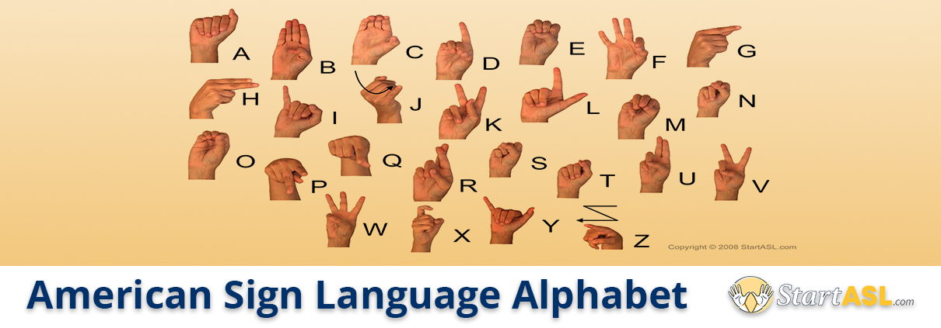
Alphabet

Slide 10
Practice time!

Slide 11
Video clip 4

Slide 12
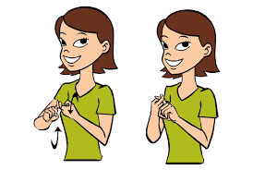
friend

Slide 13
Practice time!

Slide 14
Video Clip 5

Slide 15
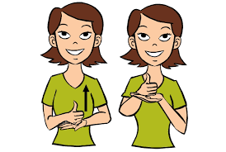
help

Slide 16
Practice time!

Slide 17
Video clip 6

Slide 18
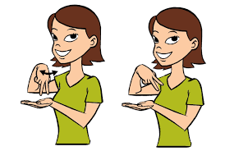
Dance

Slide 19
Practice time!

Slide 20
Video clip 7

Slide 21
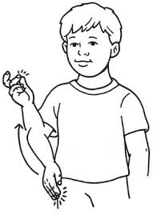
Dog

Slide 22
Practice time!

