Slide 1
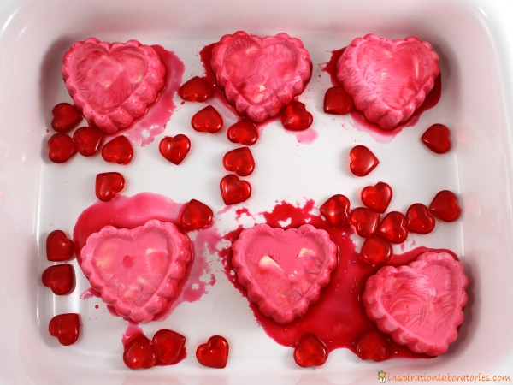
Frozen Oobleck
Supplies :
Cornstarch
Water
Liquid watercolors
Glitter (optional)
Letter tiles (optional)
Heart Mold
Add about 1/2 cup of cornstarch to a large bowl.
Slowly add up to a 1/2 cup of water. Mix until you get the consistency you desire. If you add too much water, just add more cornstarch.
Add liquid watercolors. You could also use food coloring, but it has the potential to stain. Watercolors are usually washable.
Pour the oobleck into heart molds.
Add letter tiles to spell words. Place the molds in the freezer for at least a few hours.
ENJOY! The frozen oobleck is a solid. As the oobleck melts, it’s texture and consistency changes. It will start to act like regular oobleck. It will feel like a solid when you press on it, but drip like a liquid when you let it go.

