Slide 1
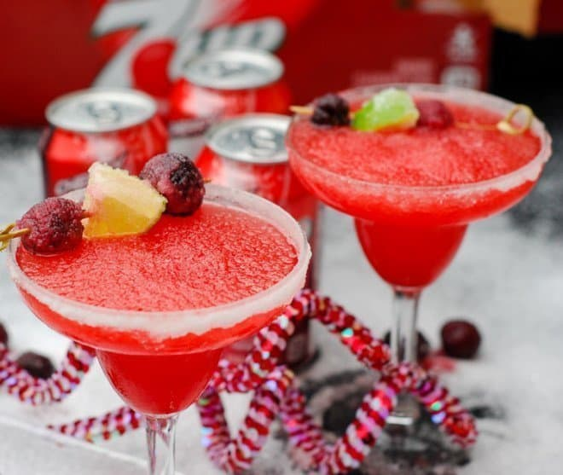
Cherry Margarita Mocktail
Toast to the new year with a fun tasty drink!
Ingredients :
1 12-oz. can frozen limeade
12 oz. Cherry 7UP®
4 Tablespoons Cherry Juice Concentrate
4-5 cups ice cubes
Cherries & Lime wedges for garnish
Sugar for rimming the glasses
Blender
In a blender, add frozen limeade, Cherry 7UP®, cherry juice concentrate and ice. Blend for 1-2 minutes or until smooth.
Before serving, rim the glasses with a lime wedge and dip in sugar.
Garnish with lime wedges and cherries

