Slide 1
Nature Scavenger Hunt!!
Lets get looking!

Slide 2
PINECONE

Slide 3
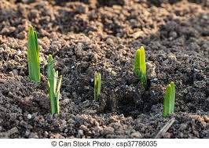
Flower Sprouts

Slide 4
Bird’s Nest

Slide 5
Feather

Slide 6
Spider Web

Slide 7
Animal Tracks

Slide 8
Worm

Slide 9
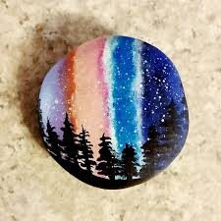
Rocks

Slide 10
Hole in a Tree

Slide 11
Pine Needle

Slide 12
Moss

Slide 13
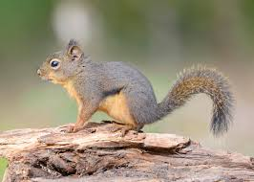
Squirrel

Slide 14
Mud

Slide 15
Rabbit

